Slide 1
Econ 642: Week 4
Microeconomic Foundations Part 1: Consumption and Labor/Leisure Decisions

Slide 2
Announcements
Discussion Week 4 is available
Problem Set 1 is due on tonight
Problem Set 2 will be posted later this week and it will be due 1/7/2025
We have a make-up class on Friday, January 17th, 2025 6:45-9:30
Presentation Set 2 is on Friday, January 17rd, when we come back

Slide 3
Overview
Chapter 6: Consumption
Keynesian view of consumption
Two-period model
Many periods
Behavioral Theories
Chapter 7: Labor and Leisure
Measuring the Labor Market
Static Model
Evidence
A Dynamic Model
Equilibrium in the Labor Market

Slide 4
Consumption
Kurlat Chapter 6

Slide 5
Overview of Consumption
We cover microeconomic foundations of consumption
Consumption
Consumption, marginal consumption, and a Keynesian view on consumption
Two-Period Model of Consumption
The Effect of Interest Rates
The Permanent Income Hypothesis
Taxes and Ricardian Equivalence
Precautionary Savings
Extension to Many Periods
Behavioral Theories on Consumption

Slide 6
A Keynesian View of Consumption

Slide 7
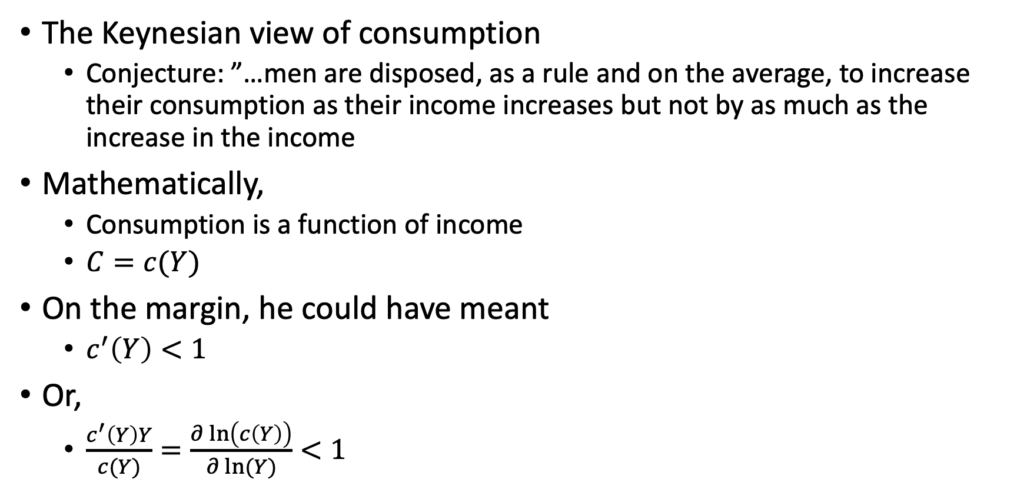
The Keynesian View of Consumption
The Keynesian view of consumption
Conjecture: ”…men are disposed, as a rule and on the average, to increase their consumption as their income increases but not by as much as the increase in the income
Mathematically,
Consumption is a function of income
$C=c(Y)$
On the margin, he could have meant
$c^{′}\left(Y\right)<1$
Or,
$\frac{c^{′}\left(Y\right)Y}{c(Y)}=\frac{∂\ln\left(c\left(Y\right)\right)}{∂\ln{(Y)}}<1$

Slide 8
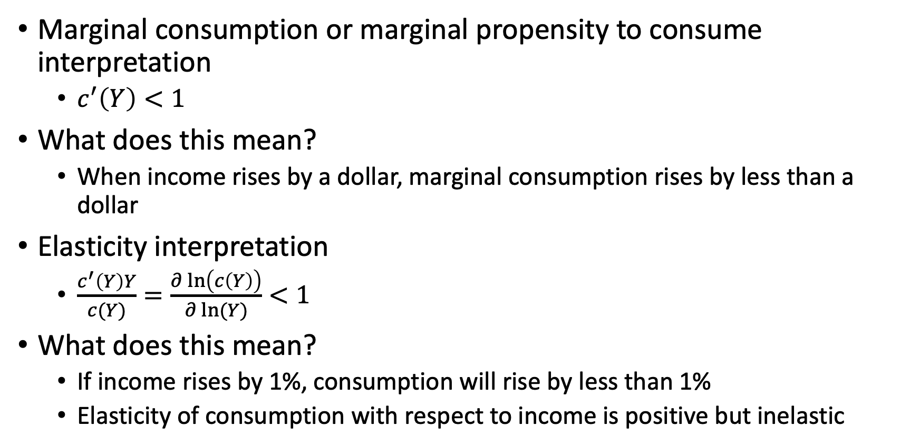
The Keynesian View of Consumption
Marginal consumption or marginal propensity to consume interpretation
$c^{′}\left(Y\right)<1$
What does this mean?
When income rises by a dollar, marginal consumption rises by less than a dollar
Elasticity interpretation
$\frac{c^{′}\left(Y\right)Y}{c(Y)}=\frac{∂\ln\left(c\left(Y\right)\right)}{∂\ln{(Y)}}<1$
What does this mean?
If income rises by 1%, consumption will rise by less than 1%
Elasticity of consumption with respect to income is positive but inelastic

Slide 9
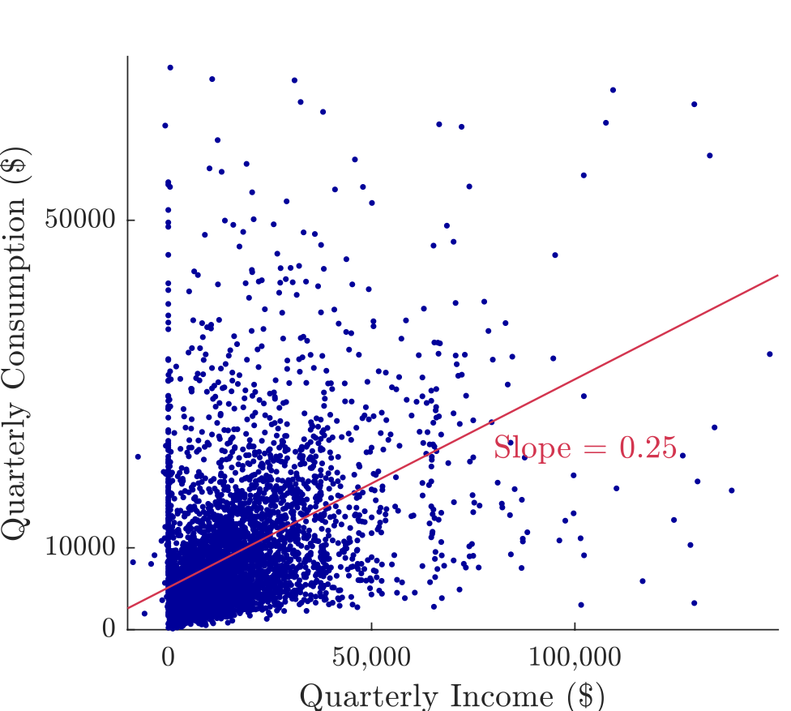
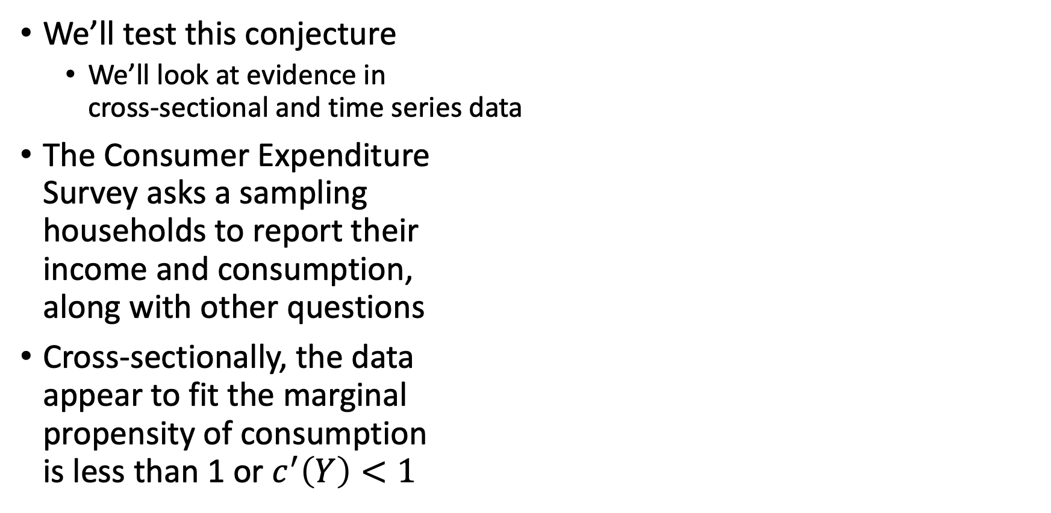
The Keynesian View of Consumption
We’ll test this conjecture
We’ll look at evidence in cross-sectional and time series data
The Consumer Expenditure Survey asks a sampling households to report their income and consumption, along with other questions
Cross-sectionally, the data appear to fit the marginal propensity of consumption is less than 1 or $c^{′}\left(Y\right)<1$

Slide 10
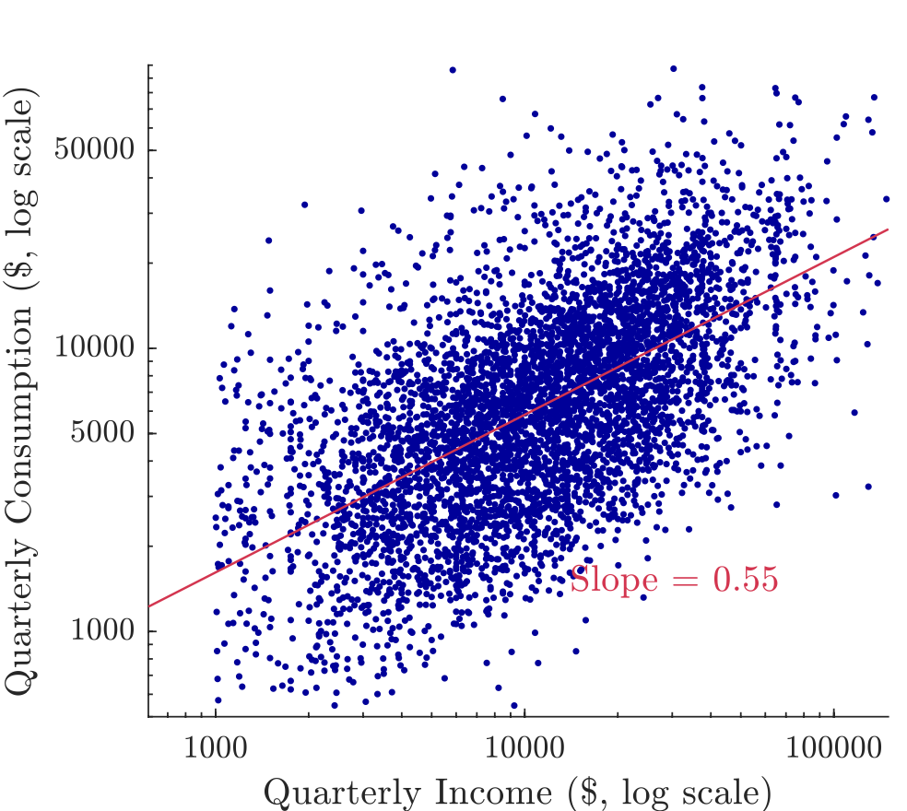
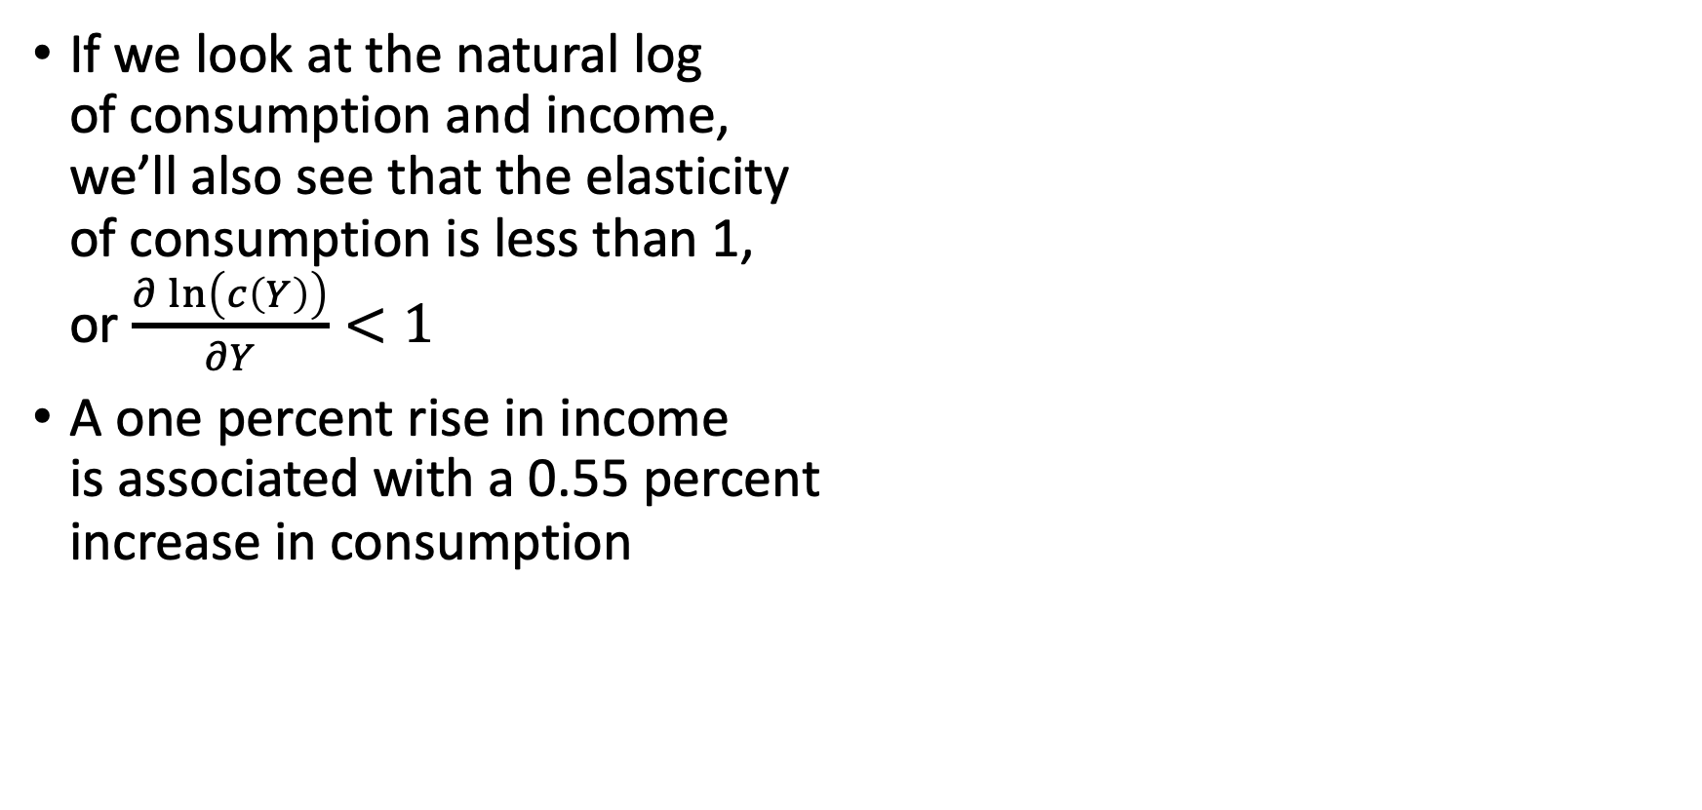
The Keynesian View of Consumption
If we look at the natural log of consumption and income, we’ll also see that the elasticity of consumption is less than 1, or $\frac{∂\ln\left(c\left(Y\right)\right)}{∂Y}<1$
A one percent rise in income is associated with a 0.55 percent increase in consumption

Slide 11
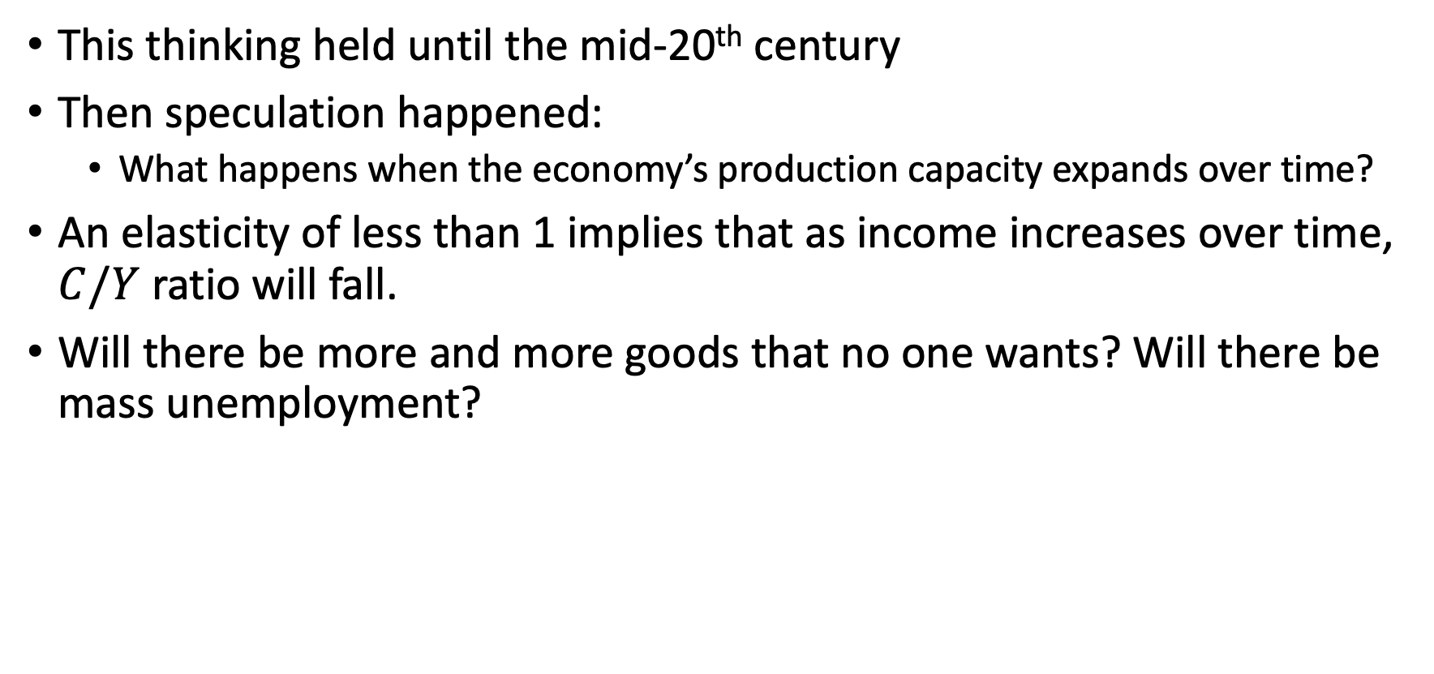
The Keynesian View of Consumption
This thinking held until the mid-20th century
Then speculation happened:
What happens when the economy’s production capacity expands over time?
An elasticity of less than 1 implies that as income increases over time, $C/Y$ ratio will fall.
Will there be more and more goods that no one wants? Will there be mass unemployment?

Slide 12
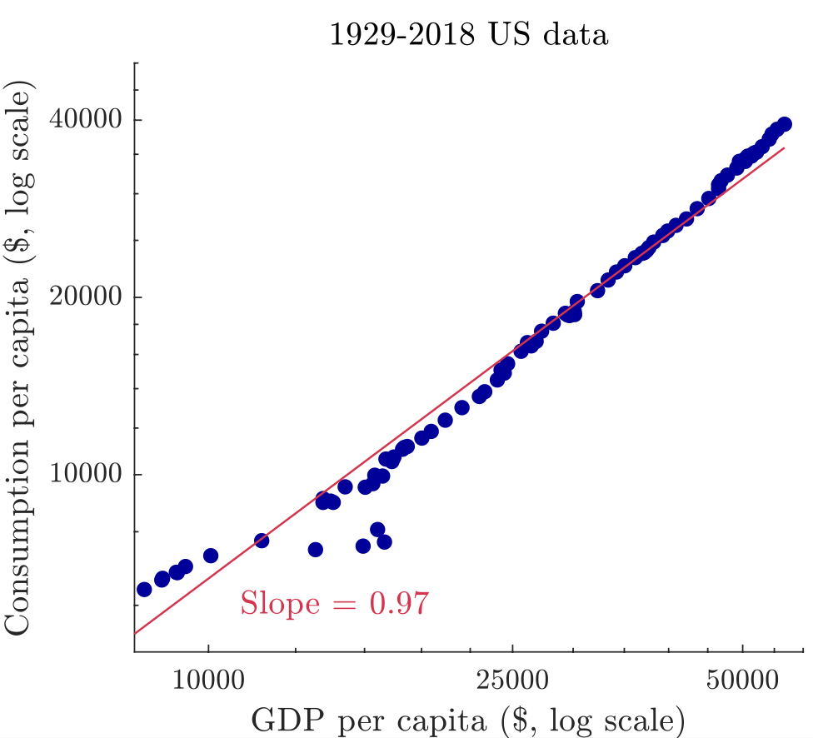
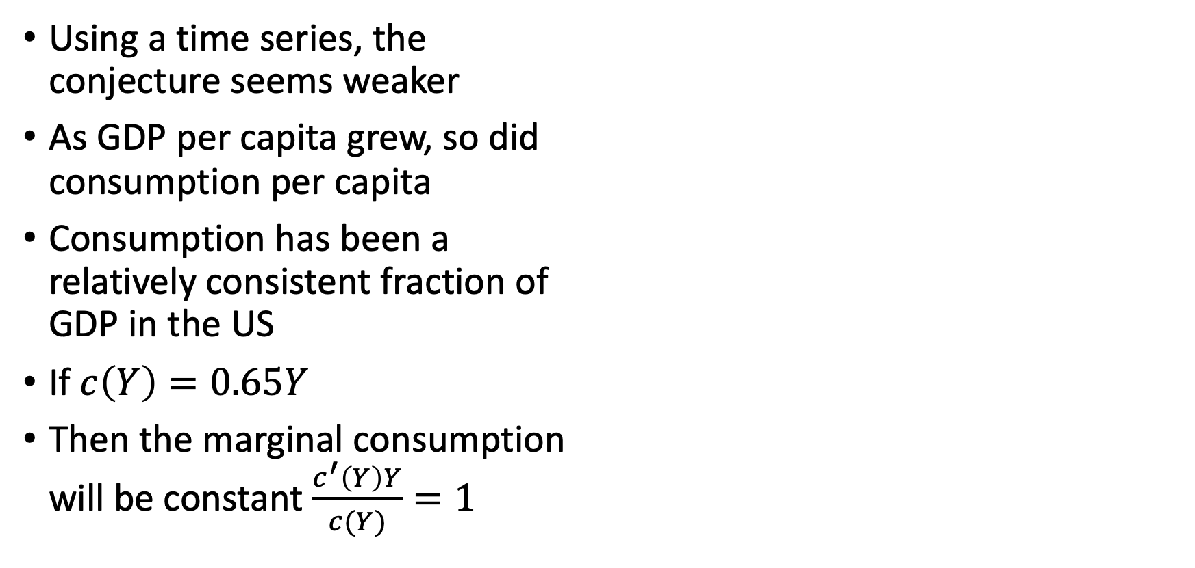
The Keynesian View of Consumption
Using a time series, the conjecture seems weaker
As GDP per capita grew, so did consumption per capita
Consumption has been a relatively consistent fraction of GDP in the US
If $c\left(Y\right)=0.65Y$
Then the marginal consumption will be constant $\frac{c^{′}\left(Y\right)Y}{c(Y)}=1$

Slide 13
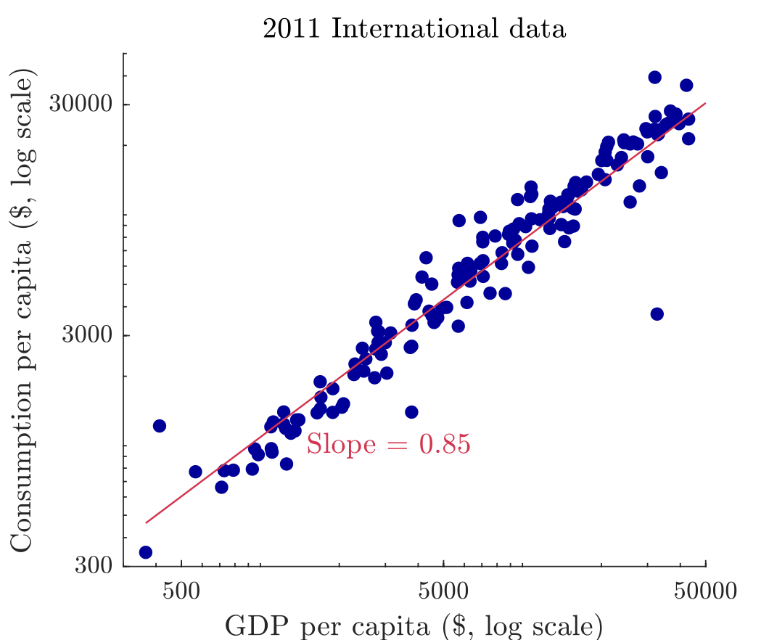
The Keynesian View of Consumption
Looking international cross- section, we see that marginal consumption is close to 1
As income grows, consumption seems to keep up for other countries

Slide 14
The Keynesian View of Consumption
Why do the cross-sectional and time-series look so different?
Cross-sectional seems to support this conjecture
Time-series appears to reject this conjecture
We’ll take a look at a 2-period consumption model as an alternative

Slide 15
A Two-Period Model of Consumption

Slide 16
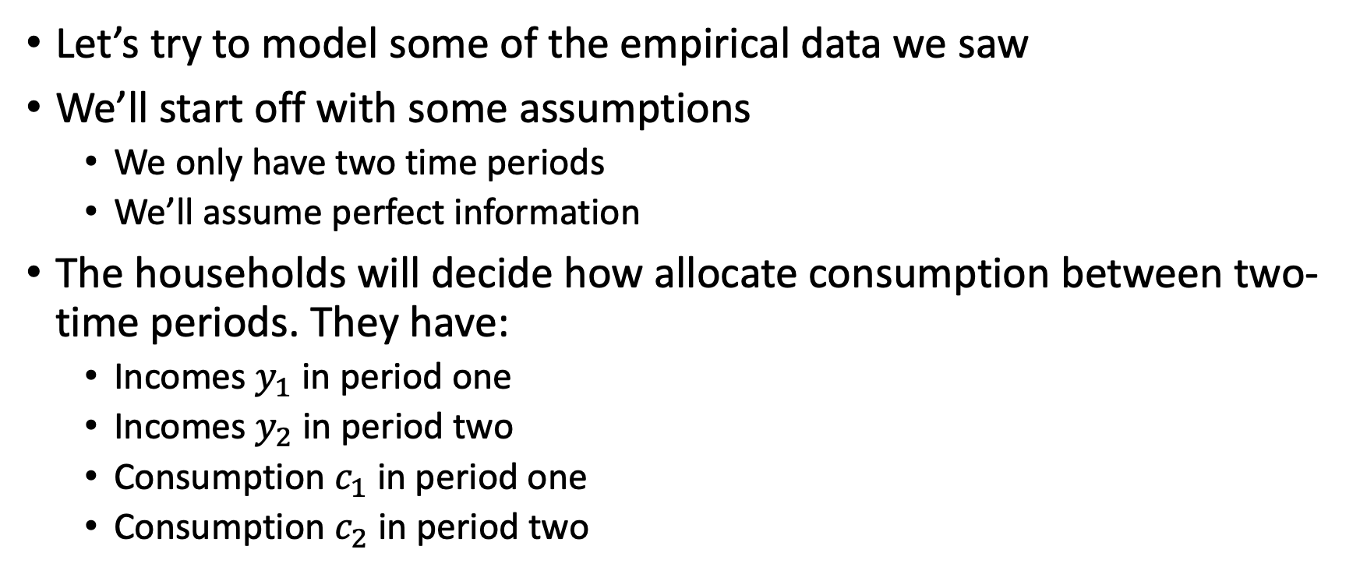
A Two-Period Model of Consumption
Let’s try to model some of the empirical data we saw
We’ll start off with some assumptions
We only have two time periods
We’ll assume perfect information
The households will decide how allocate consumption between two-time periods. They have:
Incomes $y_{1}$ in period one
Incomes $y_{2}$ in period two
Consumption $c_{1}$ in period one
Consumption $c_{2}$ in period two

Slide 17
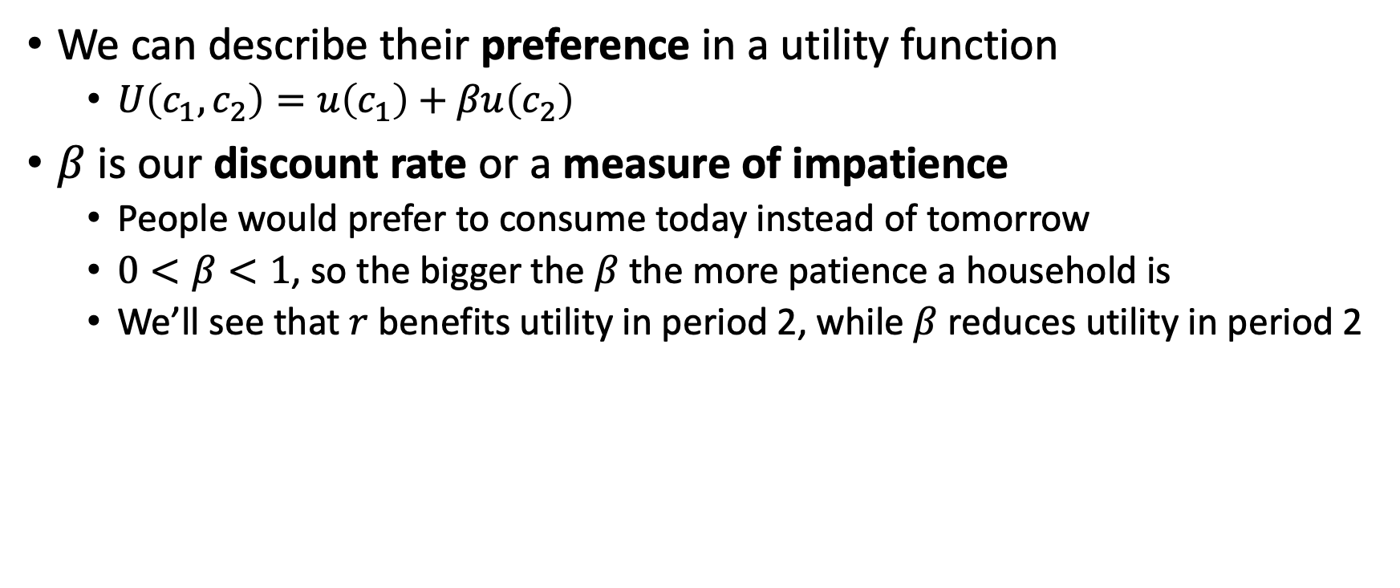
A Two-Period Model of Consumption
We can describe their preference in a utility function
$U\left(c_{1},c_{2}\right)=u\left(c_{1}\right)+βu\left(c_{2}\right)$
$β$ is our discount rate or a measure of impatience
People would prefer to consume today instead of tomorrow
$0<β<1$, so the bigger the $β$ the more patience a household is
We’ll see that $r$ benefits utility in period 2, while $β$ reduces utility in period 2

Slide 18
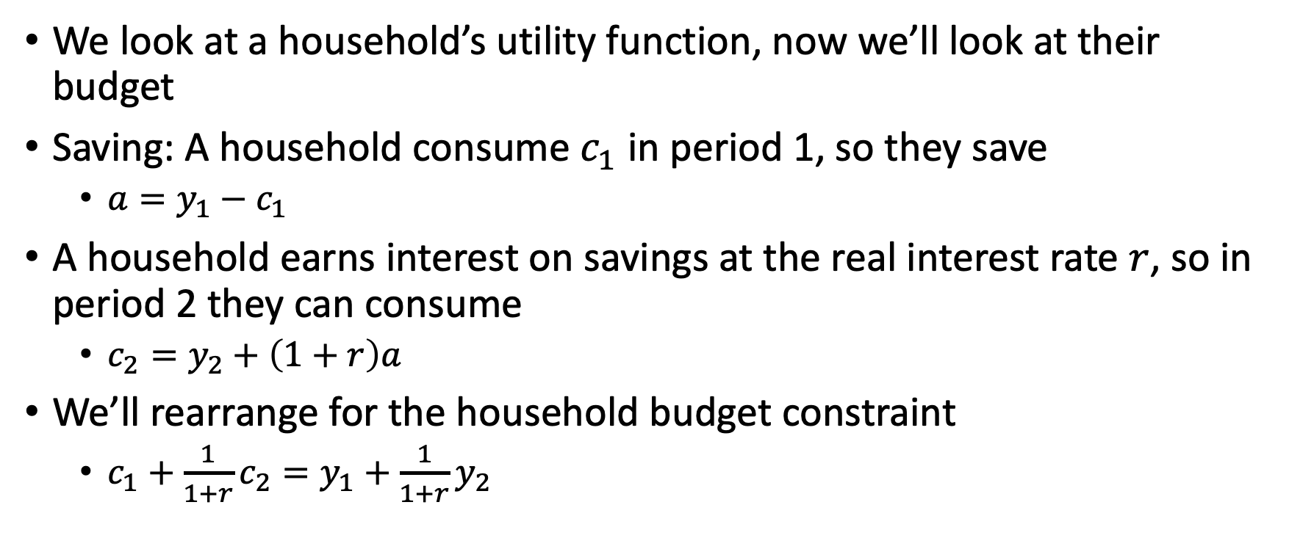
A Two-Period Model of Consumption
We look at a household’s utility function, now we’ll look at their budget
Saving: A household consume $c_{1}$ in period 1, so they save
$a=y_{1}−c_{1}$
A household earns interest on savings at the real interest rate $r$, so in period 2 they can consume
$c_{2}=y_{2}+\left(1+r\right)a$
We’ll rearrange for the household budget constraint
$c_{1}+\frac{1}{1+r}c_{2}=y_{1}+\frac{1}{1+r}y_{2}$

Slide 19
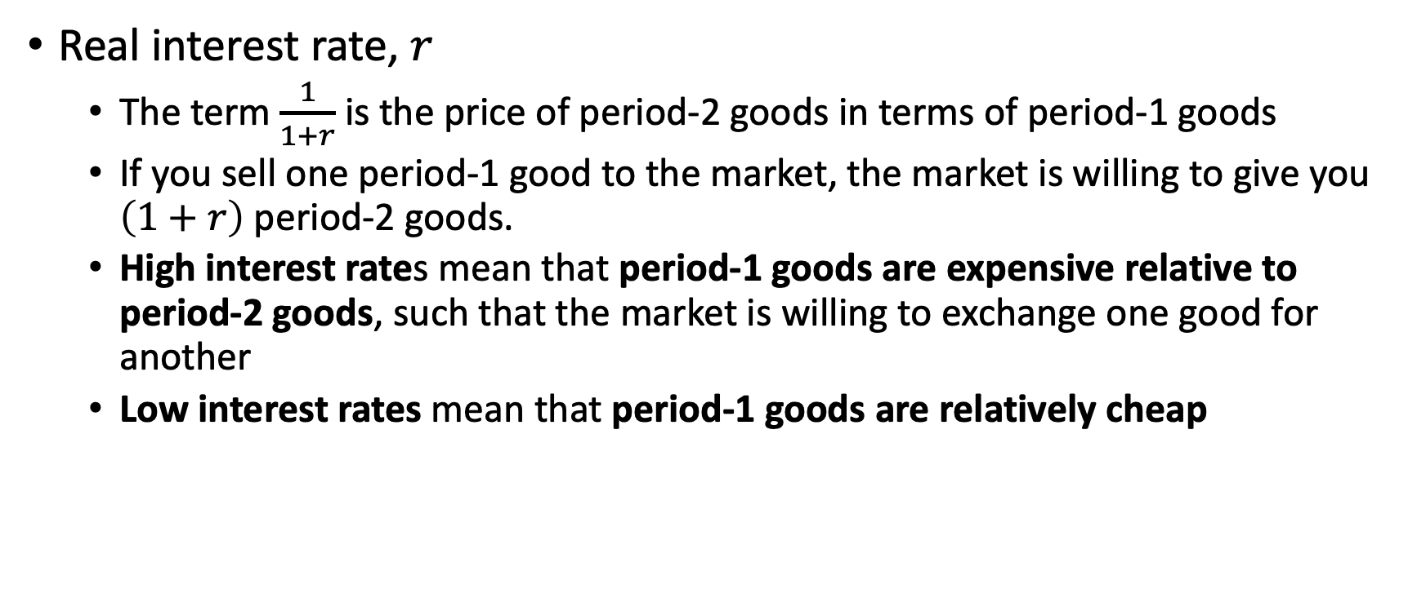
A Two-Period Model of Consumption
Real interest rate, $r$
The term $\frac{1}{1+r}$ is the price of period-2 goods in terms of period-1 goods
If you sell one period-1 good to the market, the market is willing to give you $\left(1+r\right)$ period-2 goods.
High interest rates mean that period-1 goods are expensive relative to period-2 goods, such that the market is willing to exchange one good for another
Low interest rates mean that period-1 goods are relatively cheap

Slide 20
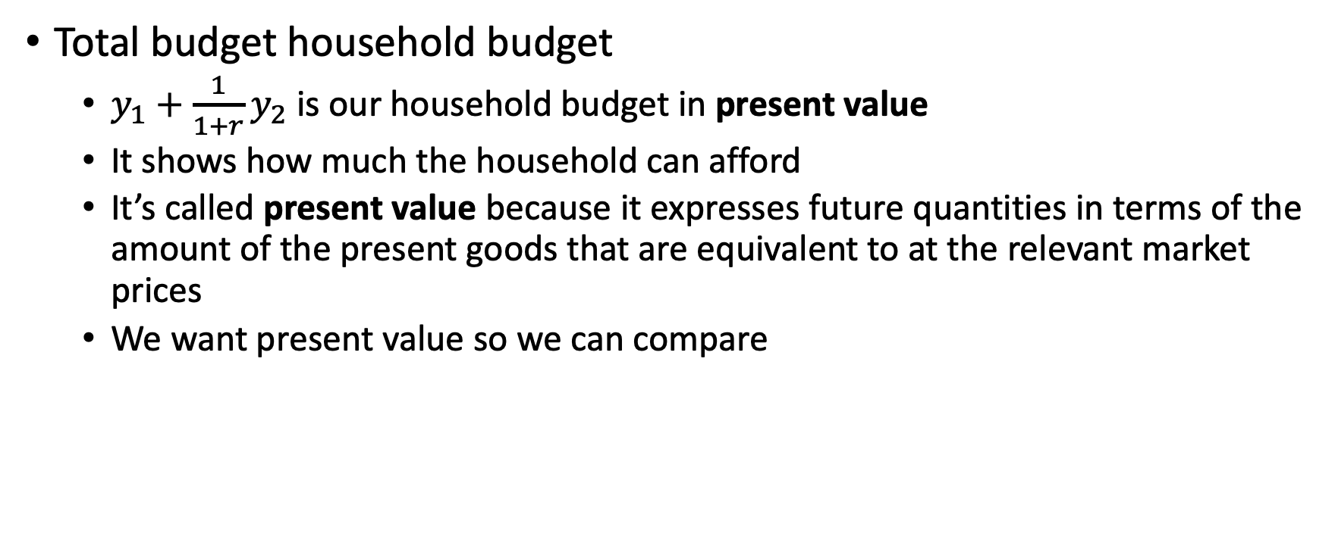
A Two-Period Model of Consumption
Total budget household budget
$y_{1}+\frac{1}{1+r}y_{2}$ is our household budget in present value
It shows how much the household can afford
It’s called present value because it expresses future quantities in terms of the amount of the present goods that are equivalent to at the relevant market prices
We want present value so we can compare

Slide 21
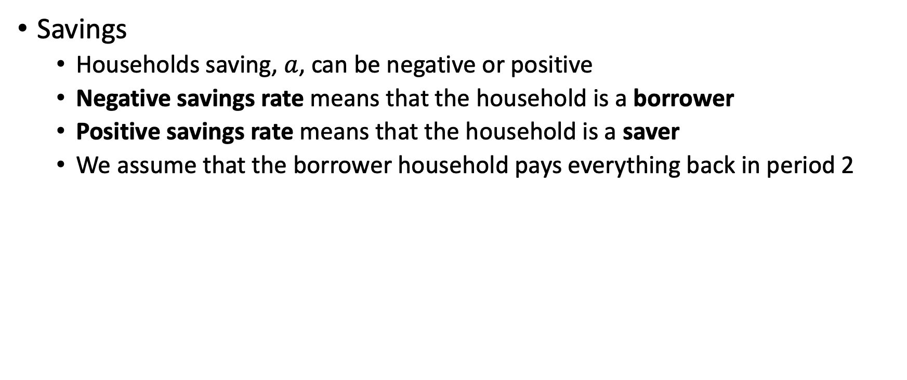
A Two-Period Model of Consumption
Savings
Households saving, $a$, can be negative or positive
Negative savings rate means that the household is a borrower
Positive savings rate means that the household is a saver
We assume that the borrower household pays everything back in period 2

Slide 22
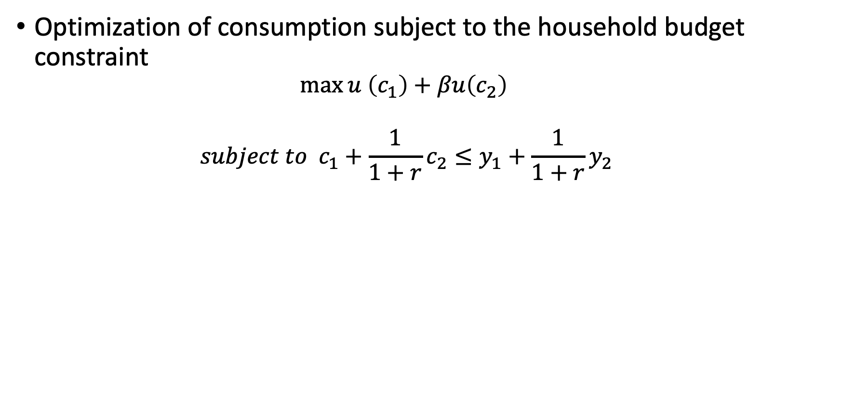
A Two-Period Model of Consumption
Optimization of consumption subject to the household budget constraint
$$\max{u \left(c_{1}\right)+βu\left(c_{2}\right)}$$
$$subject to c_{1}+\frac{1}{1+r}c_{2}≤y_{1}+\frac{1}{1+r}y_{2}$$

Slide 23
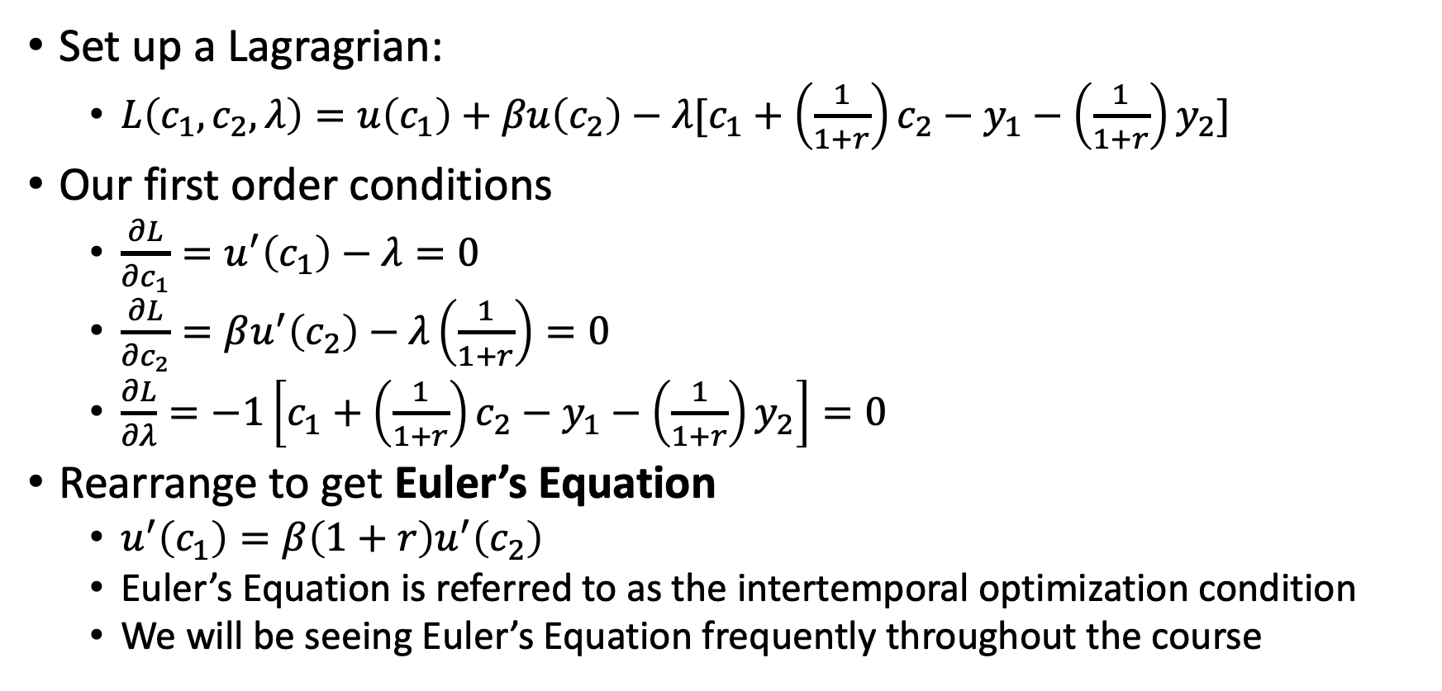
A Two-Period Model of Consumption
Set up a Lagragrian:
$L\left(c_{1},c_{2},λ\right)=u\left(c_{1}\right)+βu\left(c_{2}\right)−λ[c_{1}+\left(\frac{1}{1+r}\right)c_{2}−y_{1}−\left(\frac{1}{1+r}\right)y_{2}]$
Our first order conditions
$\frac{∂L}{∂c_{1}}=u^{′}\left(c_{1}\right)−λ=0$
$\frac{∂L}{∂c_{2}}=βu^{′}\left(c_{2}\right)−λ\left(\frac{1}{1+r}\right)=0$
$\frac{∂L}{∂λ}=−1\left[c_{1}+\left(\frac{1}{1+r}\right)c_{2}−y_{1}−\left(\frac{1}{1+r}\right)y_{2}\right]=0$
Rearrange to get Euler’s Equation
$u^{′}\left(c_{1}\right)=β\left(1+r\right)u^{′}\left(c_{2}\right)$
Euler’s Equation is referred to as the intertemporal optimization condition
We will be seeing Euler’s Equation frequently throughout the course

Slide 24
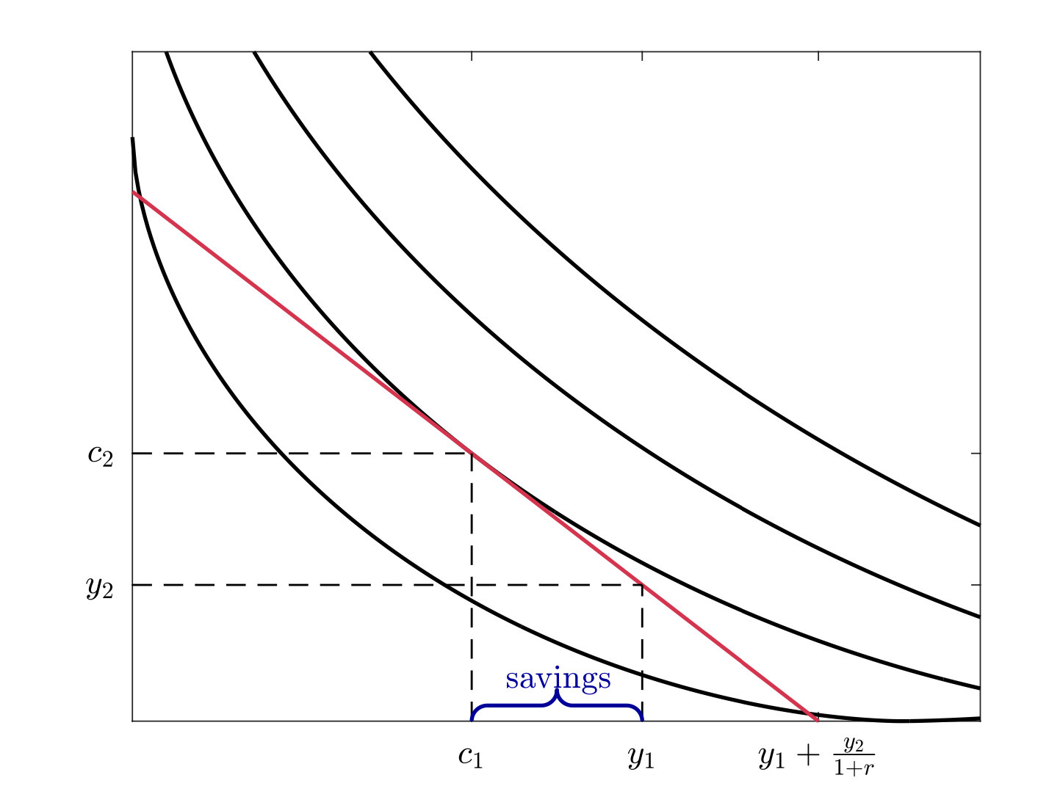
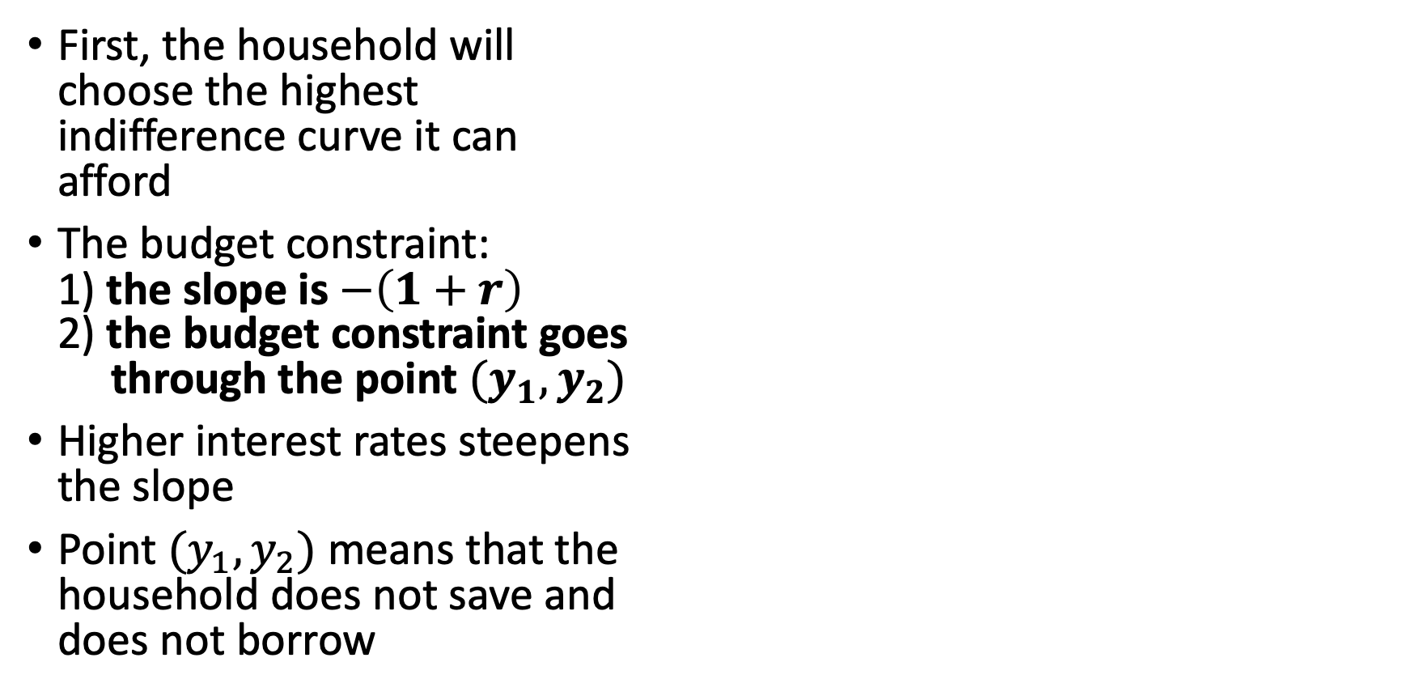
A Two-Period Model of Consumption
First, the household will choose the highest indifference curve it can afford
The budget constraint: 1) the slope is $−\left(1+r\right)$ 2) the budget constraint goes through the point $(y_{1},y_{2})$
Higher interest rates steepens the slope
Point $(y_{1},y_{2})$ means that the household does not save and does not borrow

Slide 25
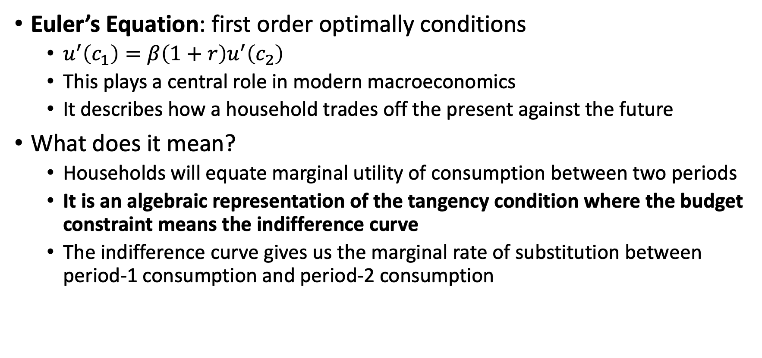
A Two-Period Model of Consumption
Euler’s Equation: first order optimally conditions
$u^{′}\left(c_{1}\right)=β\left(1+r\right)u^{′}\left(c_{2}\right)$
This plays a central role in modern macroeconomics
It describes how a household trades off the present against the future
What does it mean?
Households will equate marginal utility of consumption between two periods
It is an algebraic representation of the tangency condition where the budget constraint means the indifference curve
The indifference curve gives us the marginal rate of substitution between period-1 consumption and period-2 consumption

Slide 26
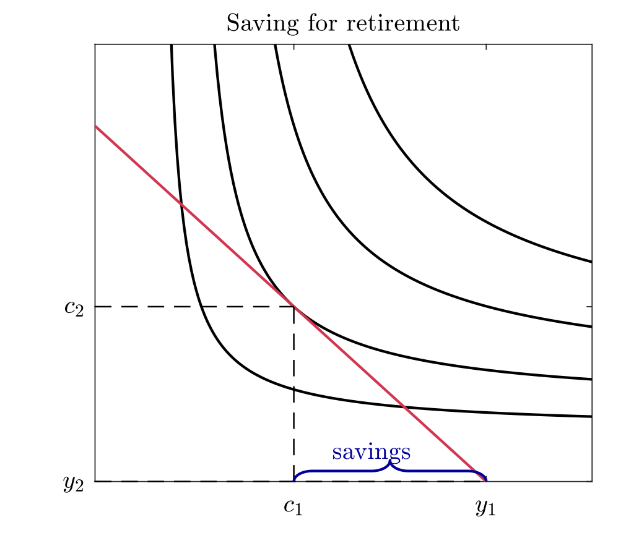
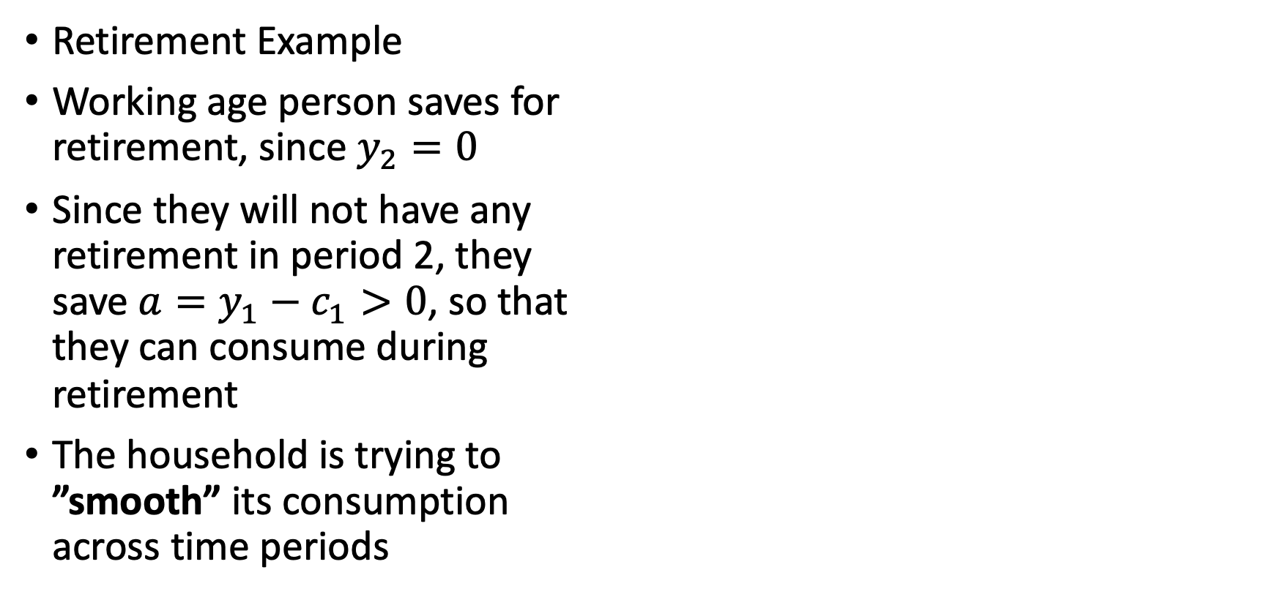
A Two-Period Model of Consumption
Retirement Example
Working age person saves for retirement, since $y_{2}=0$
Since they will not have any retirement in period 2, they save $a=y_{1}−c_{1}>0$, so that they can consume during retirement
The household is trying to ”smooth” its consumption across time periods

Slide 27
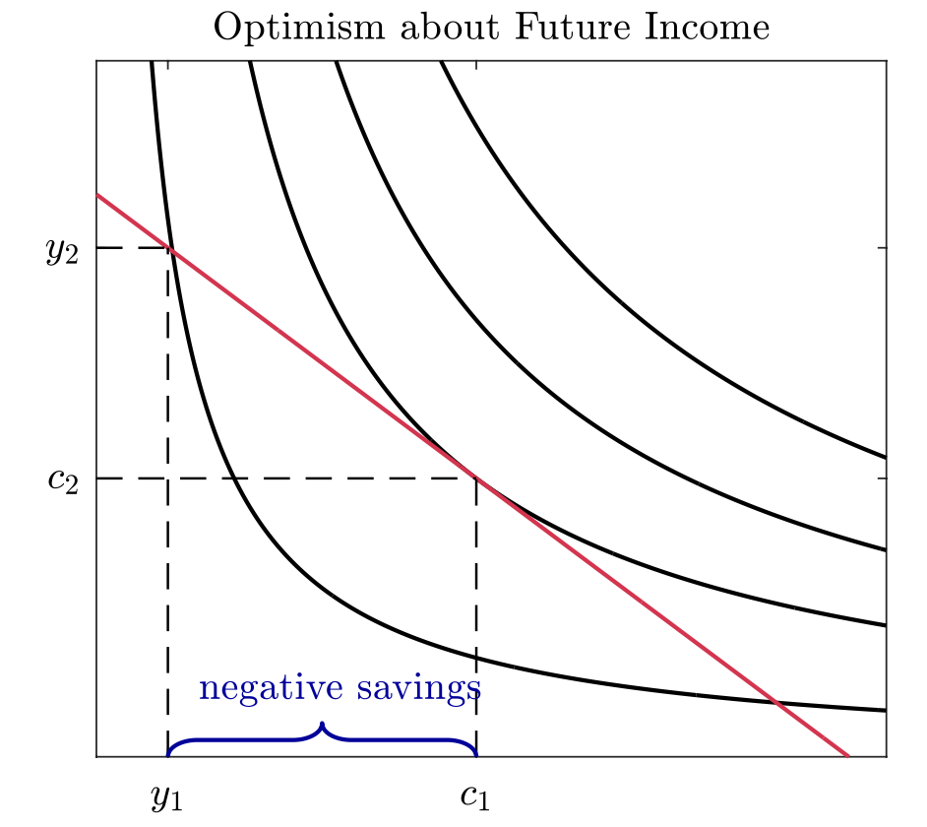
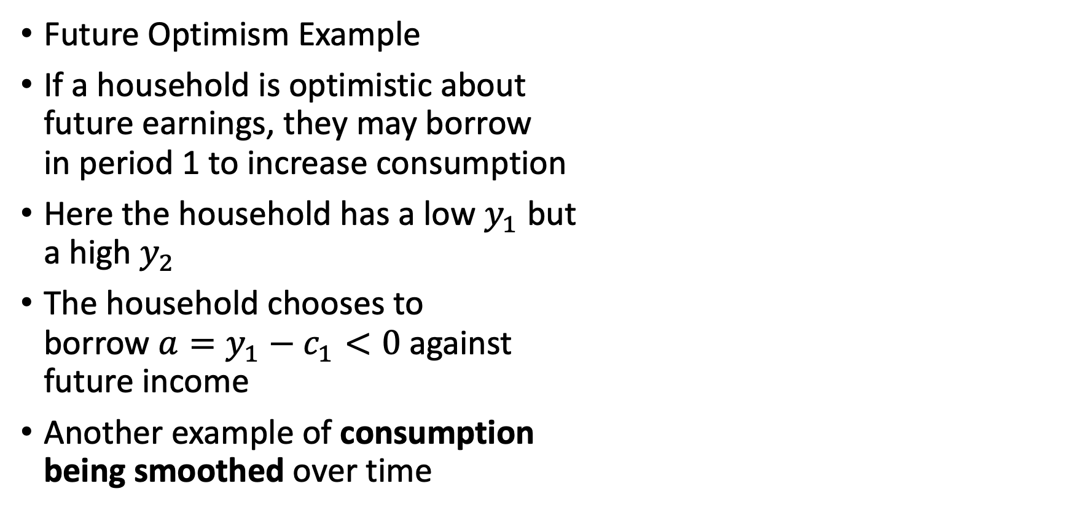
A Two-Period Model of Consumption
Future Optimism Example
If a household is optimistic about future earnings, they may borrow in period 1 to increase consumption
Here the household has a low $y_{1}$ but a high $y_{2}$
The household chooses to borrow $a=y_{1}−c_{1}<0$ against future income
Another example of consumption being smoothed over time

Slide 28
The Effect of Interest Rates on Consumption

Slide 29
The Effect of Interest Rates
How does a household change consumption when real interest rates change?
A change in the interest rate changes the household budget constraint, similar to a change in prices
Interest rates will shift the slope of the budget constraint
A higher interest rate makes the budget constraint steeper
If interest rates go up, period-1 consumption becomes more expensive relative to period-2 consumption, but
If interest rates go down, period-1 consumption becomes cheaper compared to period-2 consumption
When interest rates change we have two effects
1) Income Effect
2) Substitution Effect

Slide 30
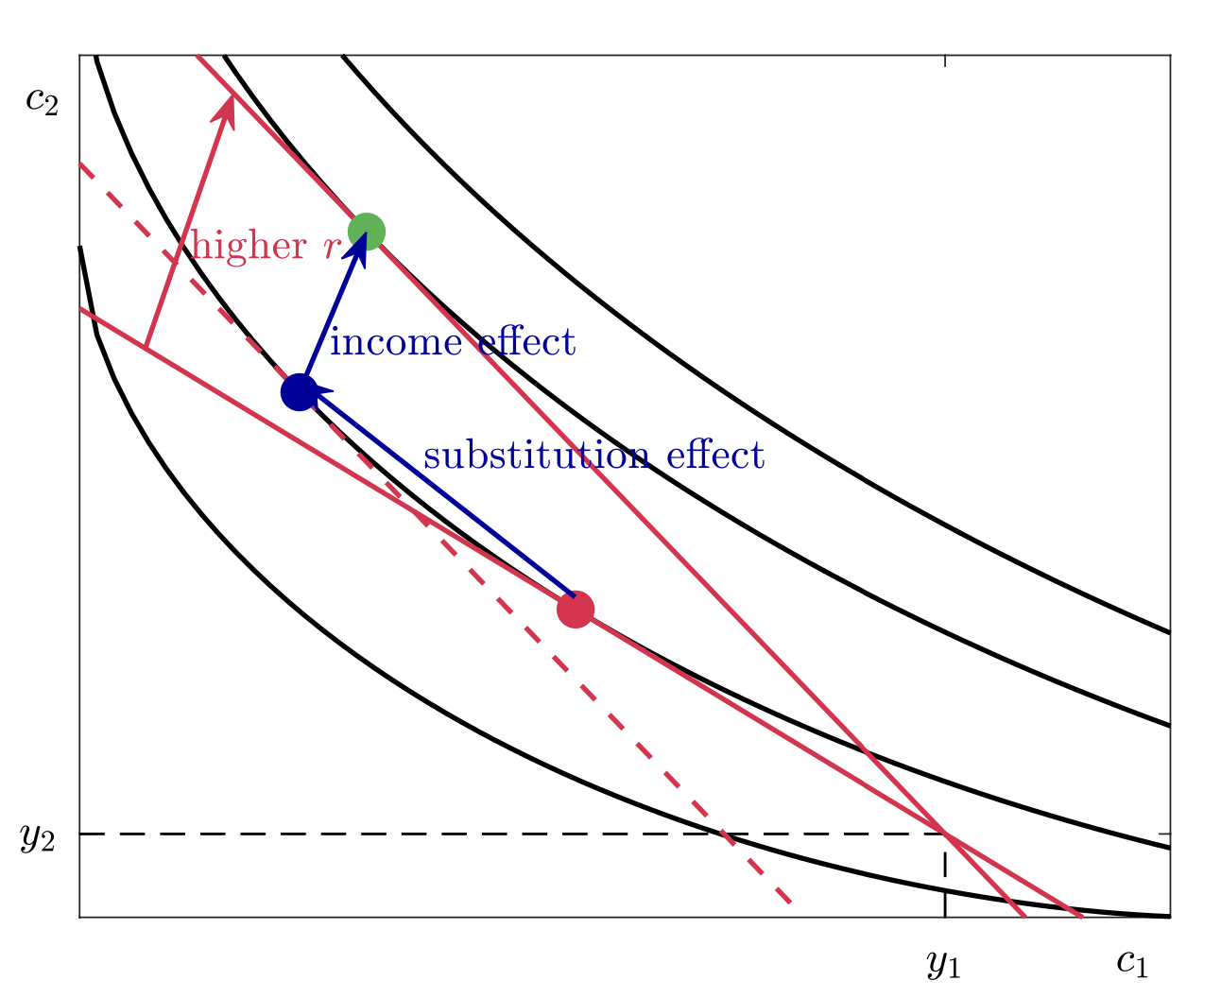
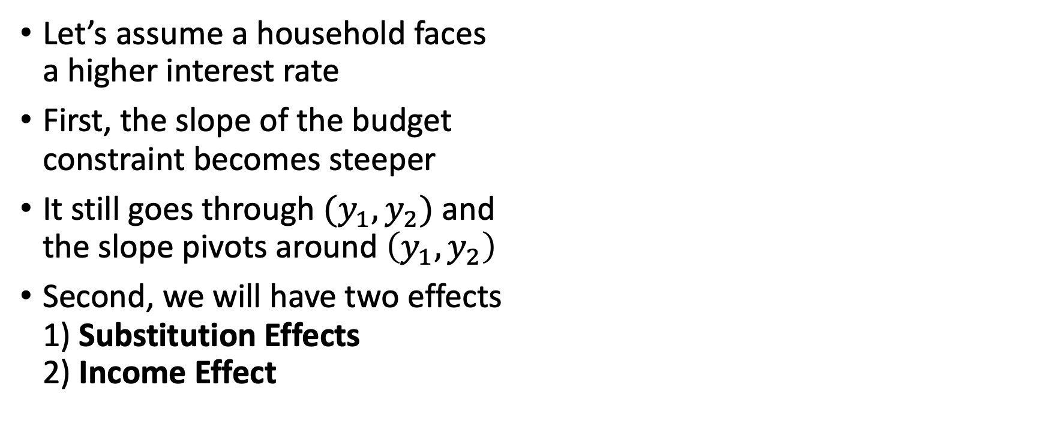
The Effect of Interest Rates
Let’s assume a household faces a higher interest rate
First, the slope of the budget constraint becomes steeper
It still goes through $(y_{1},y_{2})$ and the slope pivots around $\left(y_{1},y_{2}\right)$
Second, we will have two effects 1) Substitution Effects 2) Income Effect

Slide 31
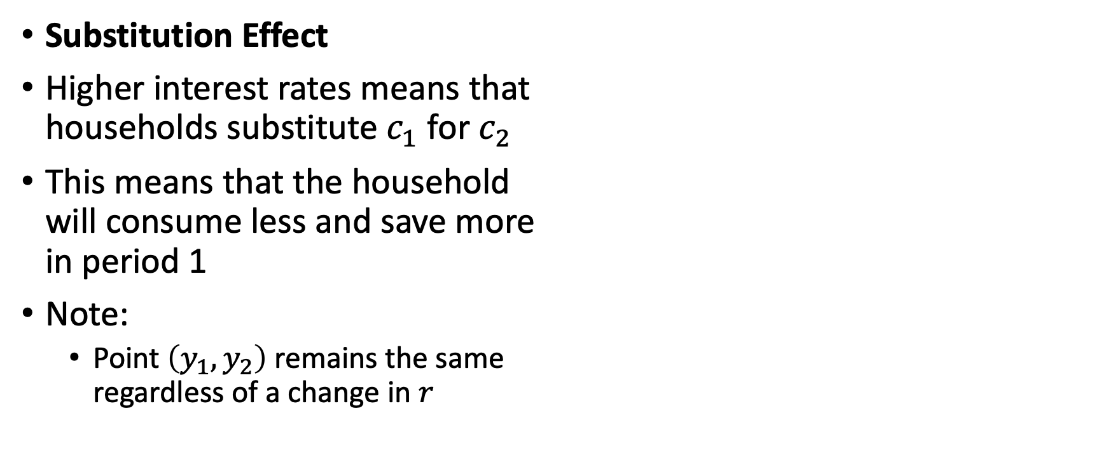
The Effect of Interest Rates
Substitution Effect
Higher interest rates means that households substitute $c_{1}$ for $c_{2}$
This means that the household will consume less and save more in period 1
Note:
Point $\left(y_{1},y_{2}\right)$ remains the same regardless of a change in $r$

Slide 32
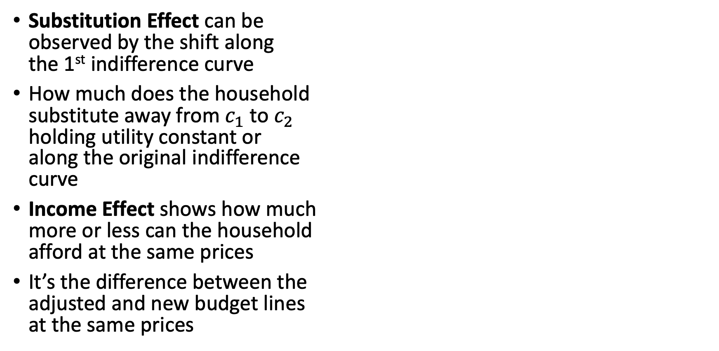
The Effect of Interest Rates
Substitution Effect can be observed by the shift along the 1st indifference curve
How much does the household substitute away from $c_{1}$ to $c_{2}$ holding utility constant or along the original indifference curve
Income Effect shows how much more or less can the household afford at the same prices
It’s the difference between the adjusted and new budget lines at the same prices

Slide 33
The Effect of Interest Rates
When households are savers the substitution effect is negative and the income effect is positive, so they push against each other and the net effect could be negative or positive
When households are borrowers the substitution and income effects are negative, then rising interest rate will reduce consumption

Slide 34
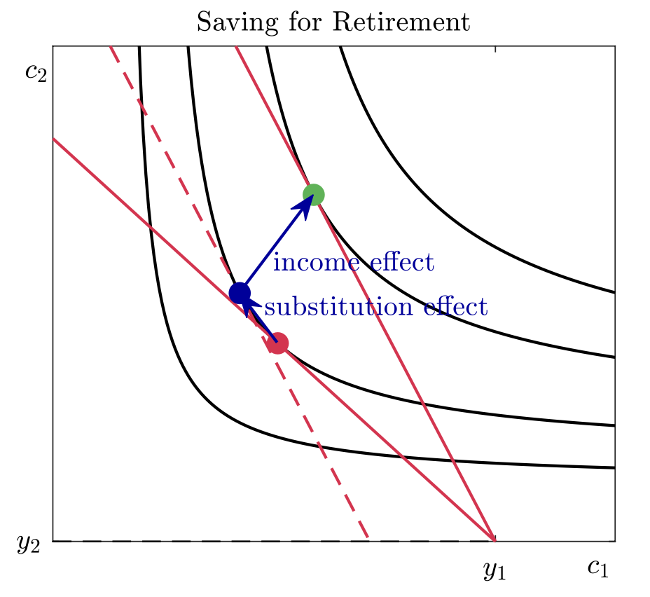
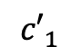
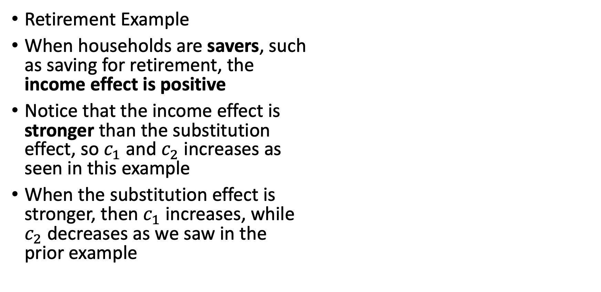
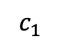
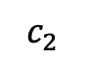
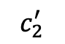
The Effect of Interest Rates
Retirement Example
When households are savers, such as saving for retirement, the income effect is positive
Notice that the income effect is stronger than the substitution effect, so $c_{1}$ and $c_{2}$ increases as seen in this example
When the substitution effect is stronger, then $c_{1}$ increases, while $c_{2}$ decreases as we saw in the prior example
$$c_{2}^{′}$$
$$c_{2}$$
$$c_{1}$$
$${c′}_{1}$$

Slide 35
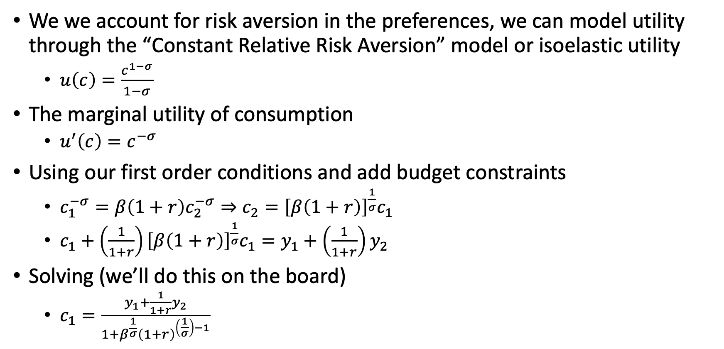
The Effect of Interest Rates
We we account for risk aversion in the preferences, we can model utility through the “Constant Relative Risk Aversion” model or isoelastic utility
$u\left(c\right)=\frac{c^{1−σ}}{1−σ}$
The marginal utility of consumption
$u^{′}\left(c\right)=c^{−σ}$
Using our first order conditions and add budget constraints
$c_{1}^{−σ}=β\left(1+r\right)c_{2}^{−σ}⇒c_{2}={\left[β\left(1+r\right)\right]}^{\frac{1}{σ}}c_{1}$
$c_{1}+\left(\frac{1}{1+r}\right){\left[β\left(1+r\right)\right]}^{\frac{1}{σ}}c_{1}=y_{1}+\left(\frac{1}{1+r}\right)y_{2}$
Solving (we’ll do this on the board)
$c_{1}=\frac{y_{1}+\frac{1}{1+r}y_{2}}{1+β^{\frac{1}{σ}}{\left(1+r\right)}^{\left(\frac{1}{σ}\right)−1}}$

Slide 36
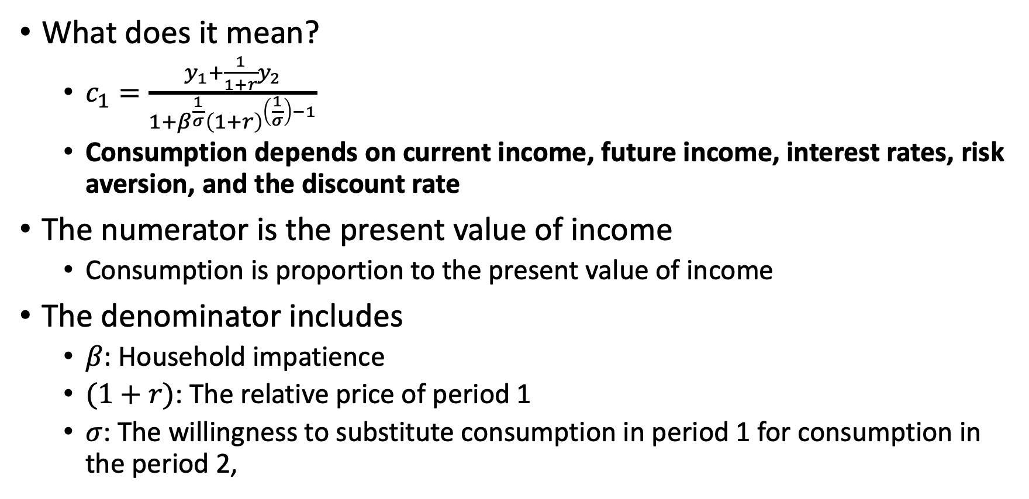
The Effect of Interest Rates
What does it mean?
$c_{1}=\frac{y_{1}+\frac{1}{1+r}y_{2}}{1+β^{\frac{1}{σ}}{\left(1+r\right)}^{\left(\frac{1}{σ}\right)−1}}$
Consumption depends on current income, future income, interest rates, risk aversion, and the discount rate
The numerator is the present value of income
Consumption is proportion to the present value of income
The denominator includes
$β$: Household impatience
$(1+r)$: The relative price of period 1
$σ$: The willingness to substitute consumption in period 1 for consumption in the period 2,

Slide 37
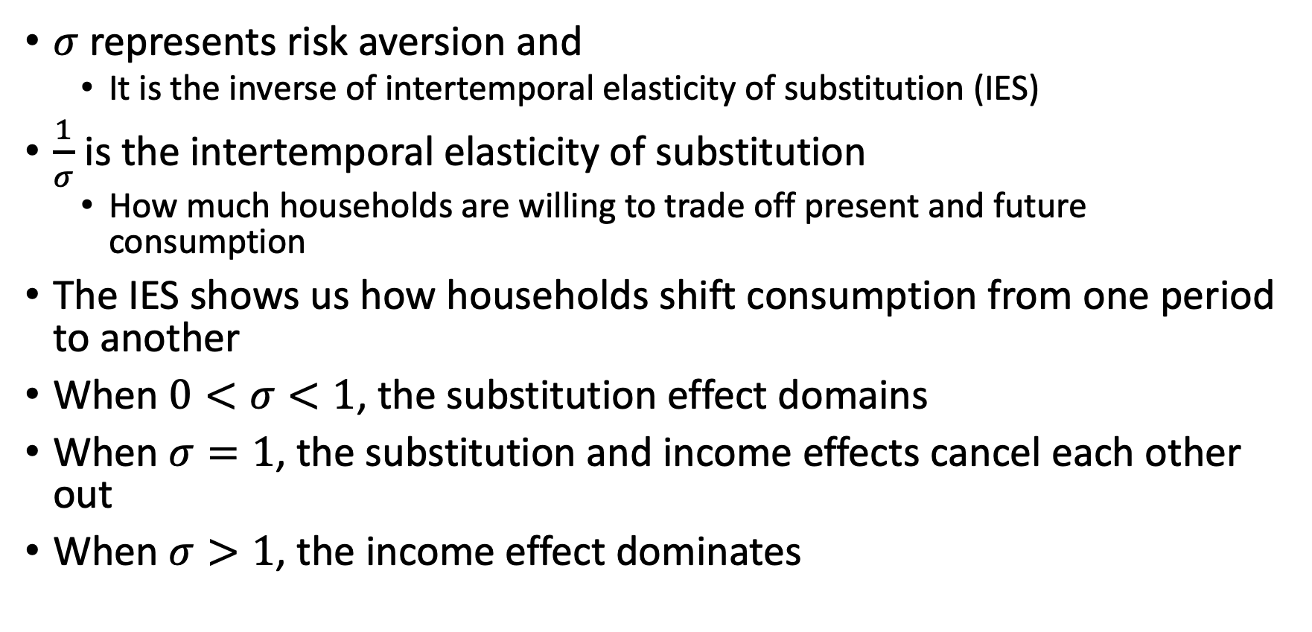
The Effect of Interest Rates
$σ$ represents risk aversion and
It is the inverse of intertemporal elasticity of substitution (IES)
$\frac{1}{σ}$ is the intertemporal elasticity of substitution
How much households are willing to trade off present and future consumption
The IES shows us how households shift consumption from one period to another
When $0<σ<1$, the substitution effect domains
When $σ=1$, the substitution and income effects cancel each other out
When $σ>1$, the income effect dominates

Slide 38
The Permanent Income Hypothesis

Slide 39
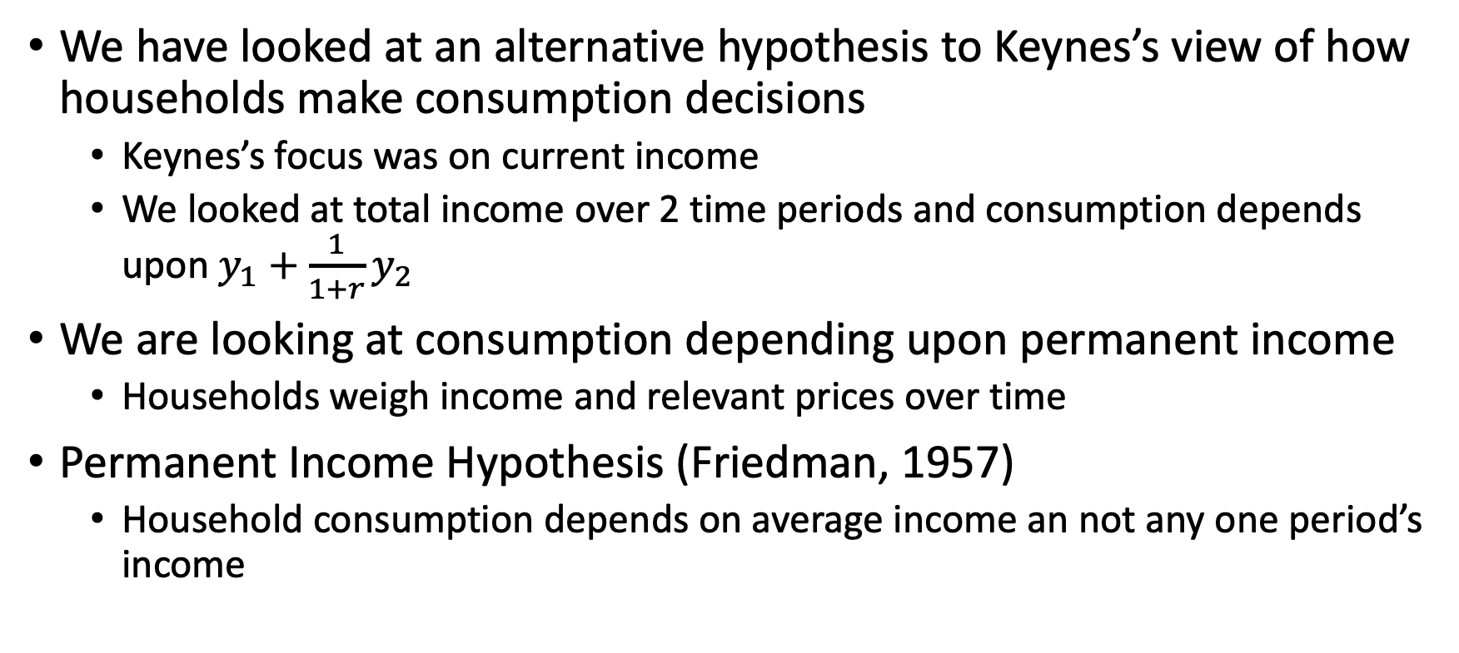
Permanent Income Hypothesis
We have looked at an alternative hypothesis to Keynes’s view of how households make consumption decisions
Keynes’s focus was on current income
We looked at total income over 2 time periods and consumption depends upon $y_{1}+\frac{1}{1+r}y_{2}$
We are looking at consumption depending upon permanent income
Households weigh income and relevant prices over time
Permanent Income Hypothesis (Friedman, 1957)
Household consumption depends on average income an not any one period’s income

Slide 40
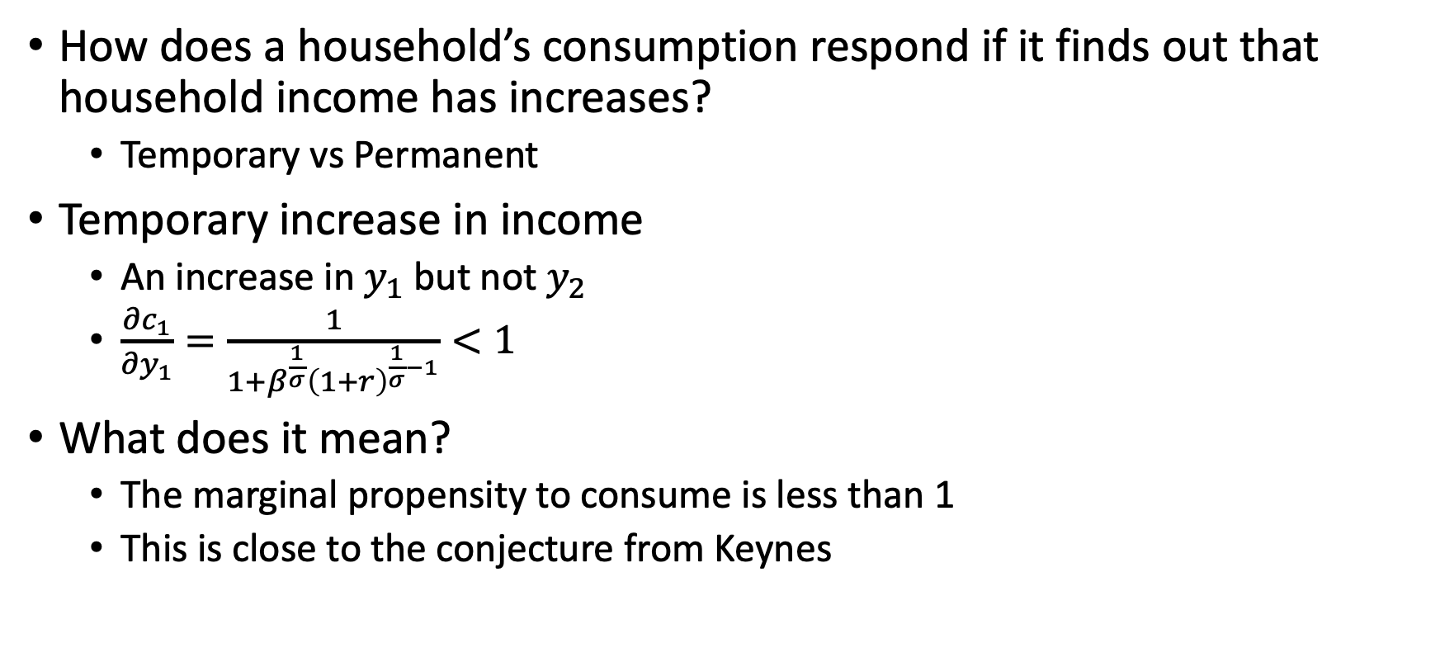
Permanent Income Hypothesis
How does a household’s consumption respond if it finds out that household income has increases?
Temporary vs Permanent
Temporary increase in income
An increase in $y_{1}$ but not $y_{2}$
$\frac{∂c_{1}}{∂y_{1}}=\frac{1}{1+β^{\frac{1}{σ}}{\left(1+r\right)}^{\frac{1}{σ}−1}}<1$
What does it mean?
The marginal propensity to consume is less than 1
This is close to the conjecture from Keynes

Slide 41
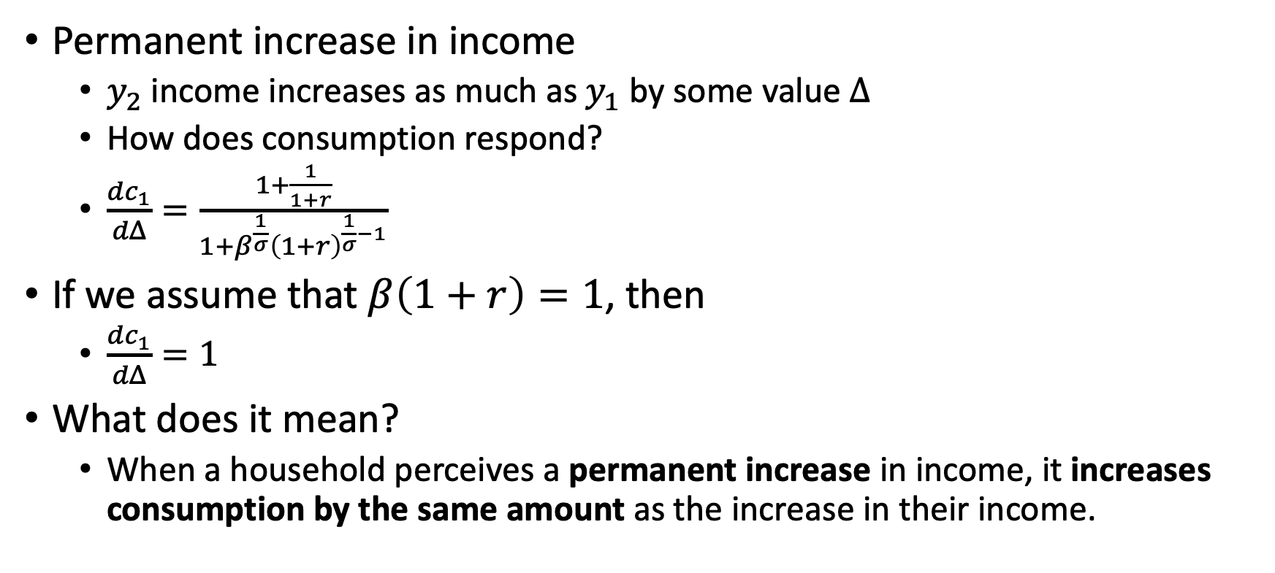
Permanent Income Hypothesis
Permanent increase in income
$y_{2}$ income increases as much as $y_{1}$ by some value $Δ$
How does consumption respond?
$\frac{dc_{1}}{dΔ}=\frac{1+\frac{1}{1+r}}{1+β^{\frac{1}{σ}}{\left(1+r\right)}^{\frac{1}{σ}−1}}$
If we assume that $β\left(1+r\right)=1$, then
$\frac{dc_{1}}{dΔ}=1$
What does it mean?
When a household perceives a permanent increase in income, it increases consumption by the same amount as the increase in their income.

Slide 42
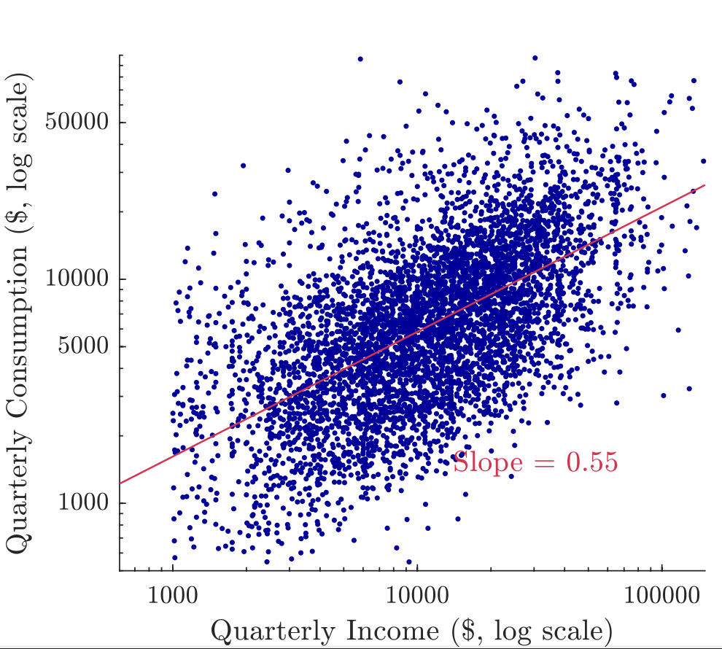
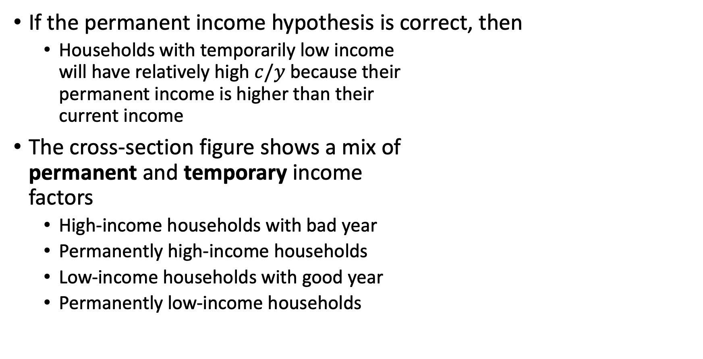
Permanent Income Hypothesis
If the permanent income hypothesis is correct, then
Households with temporarily low income will have relatively high $c/y$ because their permanent income is higher than their current income
The cross-section figure shows a mix of permanent and temporary income factors
High-income households with bad year
Permanently high-income households
Low-income households with good year
Permanently low-income households

Slide 43
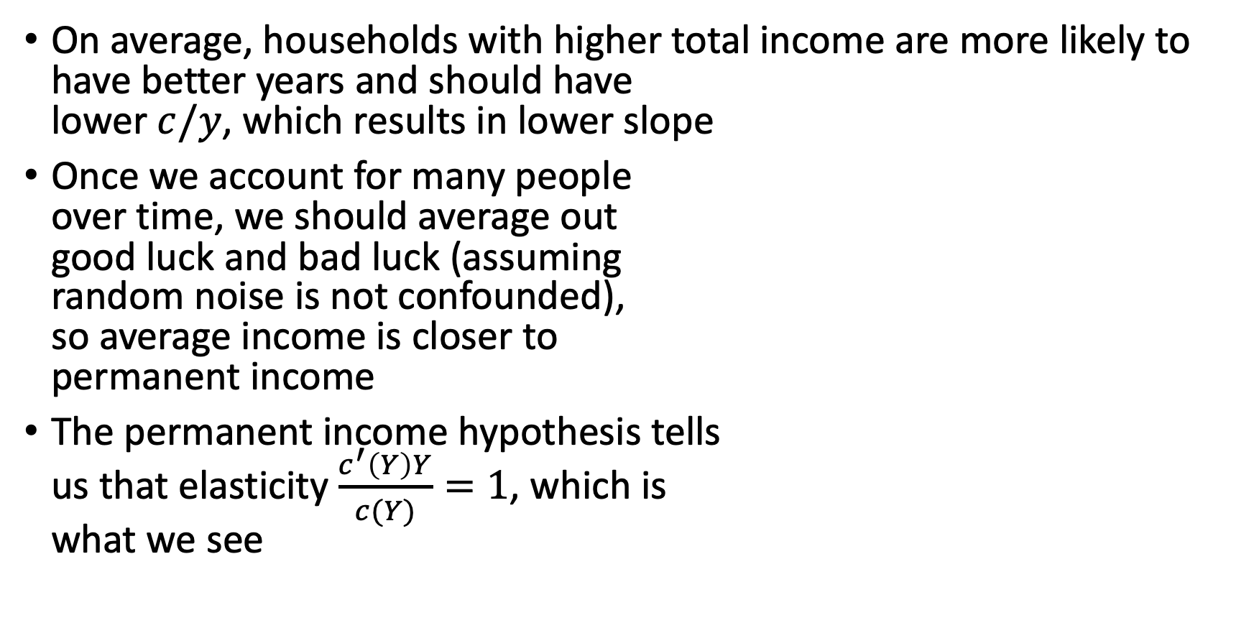
Permanent Income Hypothesis
On average, households with higher total income are more likely to have better years and should have lower $c/y$, which results in lower slope
Once we account for many people over time, we should average out good luck and bad luck (assuming random noise is not confounded), so average income is closer to permanent income
The permanent income hypothesis tells us that elasticity $\frac{c^{′}\left(Y\right)Y}{c(Y)}=1$, which is what we see

Slide 44
Taxes and Ricardian Equivalence

Slide 45
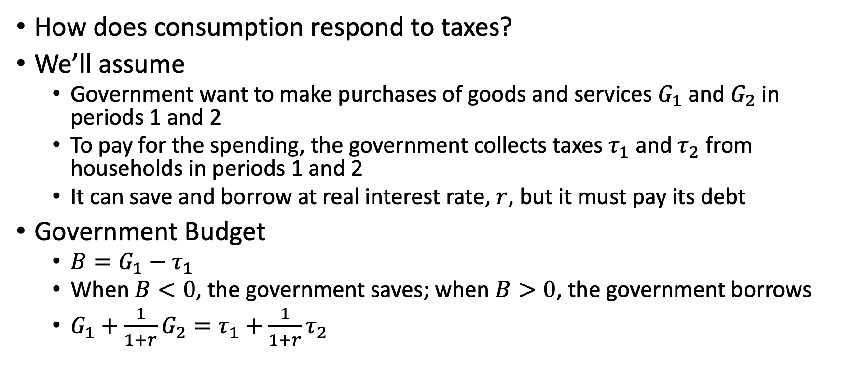
Taxes and Ricardian Equivalence
How does consumption respond to taxes?
We’ll assume
Government want to make purchases of goods and services $G_{1}$ and $G_{2}$ in periods 1 and 2
To pay for the spending, the government collects taxes $τ_{1}$ and $τ_{2}$ from households in periods 1 and 2
It can save and borrow at real interest rate, $r$, but it must pay its debt
Government Budget
$B=G_{1}−τ_{1}$
When $B<0$, the government saves; when $B>0$, the government borrows
$G_{1}+\frac{1}{1+r}G_{2}=τ_{1}+\frac{1}{1+r}τ_{2}$

Slide 46
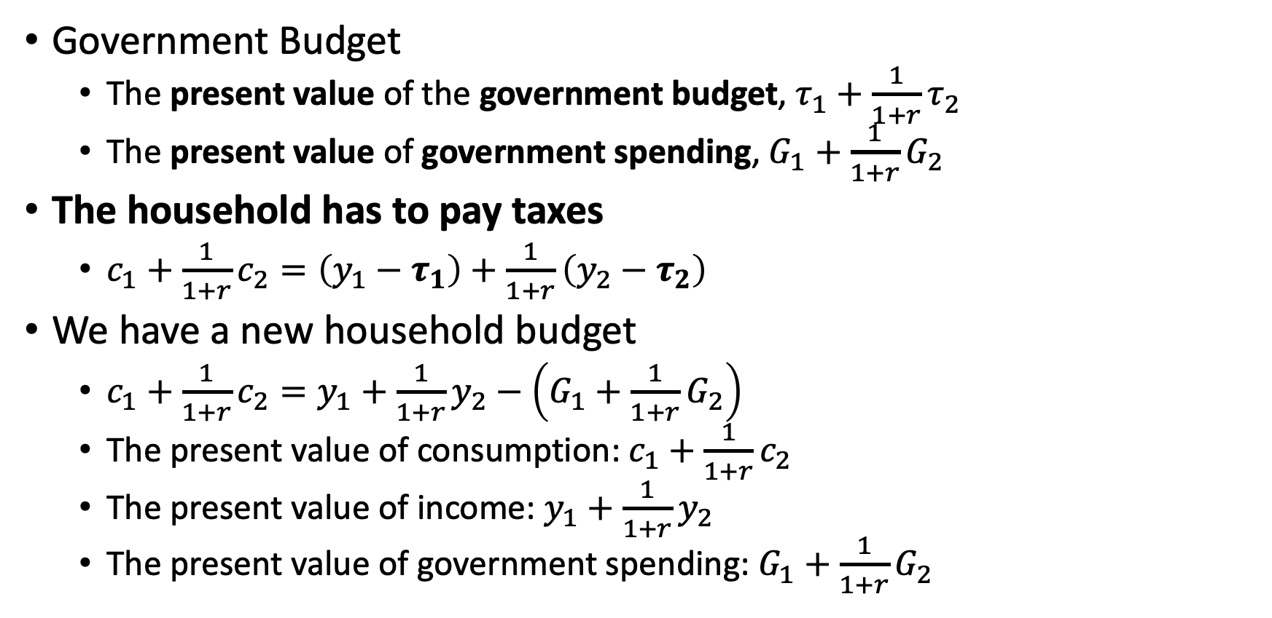
Taxes and Ricardian Equivalence
Government Budget
The present value of the government budget, $τ_{1}+\frac{1}{1+r}τ_{2}$
The present value of government spending, $G_{1}+\frac{1}{1+r}G_{2}$
The household has to pay taxes
$c_{1}+\frac{1}{1+r}c_{2}=\left(y_{1}−τ_{1}\right)+\frac{1}{1+r}\left(y_{2}−τ_{2}\right)$
We have a new household budget
$c_{1}+\frac{1}{1+r}c_{2}=y_{1}+\frac{1}{1+r}y_{2}−\left(G_{1}+\frac{1}{1+r}G_{2}\right)$
The present value of consumption: $c_{1}+\frac{1}{1+r}c_{2}$
The present value of income: $y_{1}+\frac{1}{1+r}y_{2}$
The present value of government spending: $G_{1}+\frac{1}{1+r}G_{2}$

Slide 47
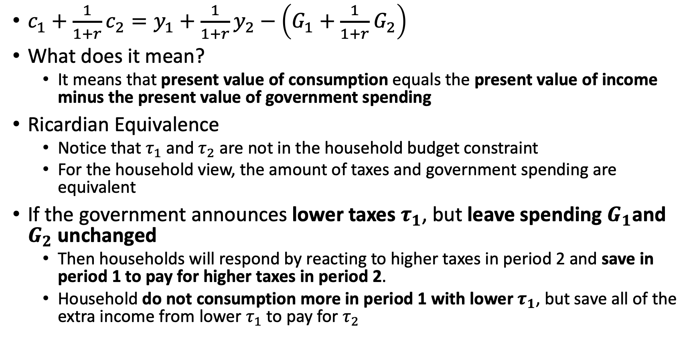
Taxes and Ricardian Equivalence
$c_{1}+\frac{1}{1+r}c_{2}=y_{1}+\frac{1}{1+r}y_{2}−\left(G_{1}+\frac{1}{1+r}G_{2}\right)$
What does it mean?
It means that present value of consumption equals the present value of income minus the present value of government spending
Ricardian Equivalence
Notice that $τ_{1}$ and $τ_{2}$ are not in the household budget constraint
For the household view, the amount of taxes and government spending are equivalent
If the government announces lower taxes $τ_{1}$, but leave spending $G_{1}$and $G_{2}$ unchanged
Then households will respond by reacting to higher taxes in period 2 and save in period 1 to pay for higher taxes in period 2.
Household do not consumption more in period 1 with lower $τ_{1}$, but save all of the extra income from lower $τ_{1}$ to pay for $τ_{2}$

Slide 48
Taxes and Ricardian Equivalence
There are several assumptions with the Ricardian Equivalence
People need to be rational and understand the government budget
Change in taxes cannot change their expectations of future government spending
Everyone, including the government, borrows, save, and lends at the same interest rate
Taxes are charged in a lump sum
Closed economy as opposed to an open economy
No uncertainty
Loosening these assumption will lead to the Ricardian Equivalence not holding

Slide 49
Precautionary Savings

Slide 50
Precautionary Savings
What happens when the assumption of no uncertainty no longer holds?
We are no longer certain about our income in the next period
Precautionary Savings
Is the savings-increasing effect of future uncertainty on consumption behavior
Introducing uncertainty increases the expected period-2 marginal utility and makes saving in period 1 more attractive

Slide 51
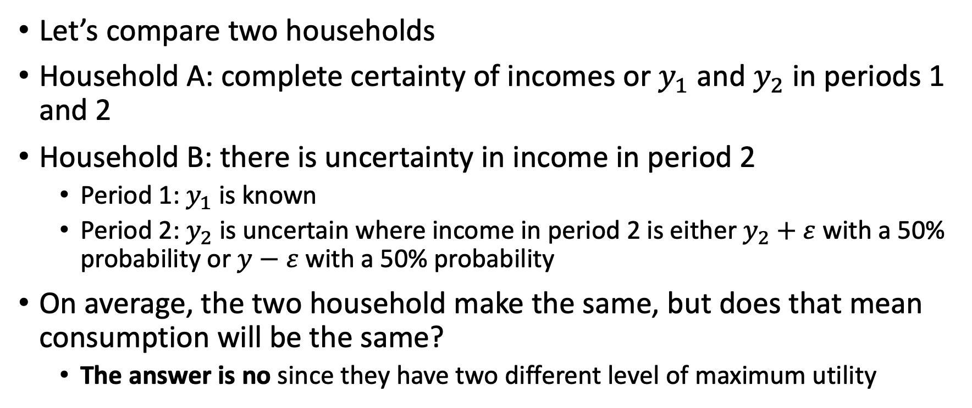
Precautionary Savings
Let’s compare two households
Household A: complete certainty of incomes or $y_{1}$ and $y_{2}$ in periods 1 and 2
Household B: there is uncertainty in income in period 2
Period 1: $y_{1}$ is known
Period 2: $y_{2}$ is uncertain where income in period 2 is either $y_{2}+ε$ with a 50% probability or $y−ε$ with a 50% probability
On average, the two household make the same, but does that mean consumption will be the same?
The answer is no since they have two different level of maximum utility

Slide 52
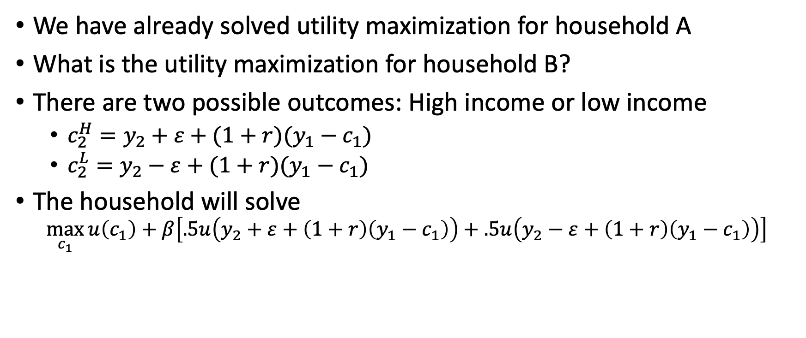
Precautionary Savings
We have already solved utility maximization for household A
What is the utility maximization for household B?
There are two possible outcomes: High income or low income
$c_{2}^{H}=y_{2}+ε+(1+r)(y_{1}−c_{1})$
$c_{2}^{L}=y_{2}−ε+(1+r)(y_{1}−c_{1})$
The household will solve
$$\max_{c_{1}}{u\left(c_{1}\right)+β\left[.5u\left(y_{2}+ε+\left(1+r\right)\left(y_{1}−c_{1}\right)\right)+.5u\left(y_{2}−ε+\left(1+r\right)\left(y_{1}−c_{1}\right)\right)\right]}$$

Slide 53
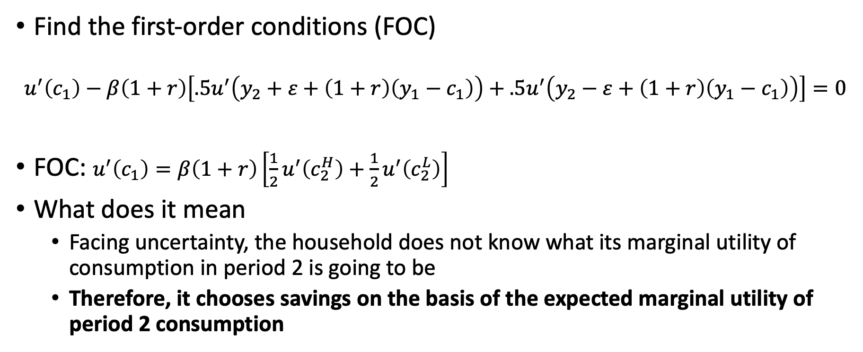
Precautionary Savings
Find the first-order conditions (FOC)
$$u^{′}\left(c_{1}\right)−β\left(1+r\right)\left[.5u^{′}\left(y_{2}+ε+\left(1+r\right)\left(y_{1}−c_{1}\right)\right)+.5u^{′}\left(y_{2}−ε+\left(1+r\right)\left(y_{1}−c_{1}\right)\right)\right]=0$$
FOC: $u^{′}\left(c_{1}\right)=β\left(1+r\right)\left[\frac{1}{2}u^{′}\left(c_{2}^{H}\right)+\frac{1}{2}u^{′}\left(c_{2}^{L}\right)\right]$
What does it mean
Facing uncertainty, the household does not know what its marginal utility of consumption in period 2 is going to be
Therefore, it chooses savings on the basis of the expected marginal utility of period 2 consumption

Slide 54


Precautionary Savings
No uncertainty, the household will consume $E\left[c\right]$ with a marginal utility of $u^{′}\left(E\left[c\right]\right)$
Introducing uncertainty means that a household will consume either at $c_{L}$ or $c_{H}$
Given $u^{′}\left(c\right)$ is convex (meaning its first derivative is negative and its second derivative is positive), then $E\left[u^{′}\left(c\right)\right]>u^{′}\left(E\left[c\right]\right)$
The Point: Introducing uncertainty incentivizes savings or precautionary savings

Slide 55

Precautionary Savings
Why should we believe that $u^{′}\left(c\right)$ is convex?
Precautionary savings are an important empirical phenomenon
If people are risk averse then $u^{′}\left(c\right)$ will be convex so it can model this preference
Constant Relative Risk Aversion
$u\left(c\right)=\frac{c^{1−σ}}{1−σ}$
$u^{′}\left(c\right)=c^{−σ}$
$u^{′′}\left(c\right)=−σc^{1+σ}<0$
$u^{′′′}\left(c\right)=σ\left(1+σ\right)c^{−\left(2+σ\right)}>0$
Part of consumption smoothing

Slide 56
Consumption Extended to Many Periods

Slide 57

Extension to Many Periods
The two-period model is very useful, but we’ll extend consumption to many time periods
It turns out that the model is very close to the 2-period model
Household preferences for consumption
$\sum_{t=0}^{T}{β^{t}u\left(c_{t}\right)}$
Consumption in future periods affect utility, but discounted by $β^{t}$ where $β<1$
Future period matter less and less the further away they are to the present
We’ll have the assumption that $T=∞$
People don’t live forever, but they may leave their money to their children

Slide 58

Extension to Many Periods
Household budget in period $t$, where household save
$a_{t+1}=\left(1+r\right)a_{t}+y_{t}−c_{t}$
Household face infinite number of constraints by linking the savings in two consecutive periods
Maximization problem with infinite number of constraints
Let’s look at period-0 and period-1 constraints with initial endowment $a_{0}$
$a_{1}=y_{0}−c_{0}+\left(1+r\right)a_{0}$
$a_{2}=y_{1}−c_{1}+\left(1+r\right)a_{1}⇒a_{2}=y_{1}−c_{1}+\left(1+r\right){\left(y_{0}−c_{0}\right)}^{1}+{\left(1+r\right)}^{2}a_{0}$
$a_{3}=y_{2}−c_{2}+\left(1+r\right){\left(y_{1}−c_{1}\right)}^{1}+{\left(1+r\right)}^{2}\left(y_{0}−c_{0}\right)+{\left(1+r\right)}^{3}a_{0}$
Generalizing
$a_{T+1}=\sum_{t=0}^{T}{y_{t}{\left(1+r\right)}^{T−t}−\sum_{t=0}^{T}{c_{t}{\left(1+r\right)}^{T−t}}}+{\left(1+r\right)}^{T+1}a_{0}$

Slide 59

Extension to Many Periods
Rearranging
$\frac{a_{T+1}}{{\left(1+r\right)}^{T}}+\sum_{t=0}^{T}{\frac{c_{t}}{{\left(1+r\right)}^{t}}}=\sum_{t=0}^{T}{\frac{y_{t}}{{\left(1+r\right)}^{t}}+\left(1+r\right)a_{0}}$
What does it mean?
We have the present value of consumption: $\sum_{t=0}^{T}{\frac{c_{t}}{{\left(1+r\right)}^{t}}}$
We have the present value of income: $\sum_{t=0}^{T}{\frac{y_{t}}{{\left(1+r\right)}^{t}}}$
We have the present value of saving at the final period: $\frac{a_{T+1}}{{\left(1+r\right)}^{T}}$
Our initial endowment (born with): $\left(1+r\right)a_{0}$
Note:
A household may decide to end in saving $a_{T+1}>0$or debt $a_{T+1}<0$
However, we assume a household pays back all debt in the final period
And no-Ponzi condition is allowed (debts don’t grow to infinity)

Slide 60

Extension to Many Periods
Putting it all together: a household maximization problem
$\max_{u}{\sum_{t=0}^{T}{β^{t}u\left(c_{t}\right)} s.t. \sum_{t=0}^{T}{\frac{c_{t}}{{\left(1+r\right)}^{t}}≤\sum_{t=0}^{T}{\frac{y_{t}}{{\left(1+r\right)}^{t}}+\left(1+r\right)a_{0}}}}$
Lagrangian:
$L\left(c_{0},c_{1},…\right)=\sum_{t=0}^{T}{β^{t}u\left(c_{t}\right)−λ\left[\sum_{t=0}^{T}{\frac{c_{t}}{{\left(1+r\right)}^{t}}−\sum_{t=0}^{T}{\frac{y_{t}}{{\left(1+r\right)}^{t}}−\left(1+r\right)a_{0}}}\right]}$
First-order Conditions
$β^{t}u^{′}\left(c_{t}\right)−λ\frac{1}{{\left(1+r\right)}^{t}}=0$
$β^{t+1}u^{′}\left(c_{t+1}\right)−λ\frac{1}{{\left(1+r\right)}^{t+1}}=0$
Solve for $λ$
$u^{′}\left(c_{t}\right)=β\left(1+r\right)u^{′}\left(c_{t+1}\right)$
What does it mean?
Euler’s Equation: it describes the tradeoff for consuming in any two consecutive periods similar to our 2-period model

Slide 61
Behavioral Theories

Slide 62
Behavioral Theories
We’ll step away from the rational assumption for a minute
People behave both rationally and irrationally
Saving for 401(k)
There is a large nudge effect for people having to opt out instead of opt in
Not-quite rational consumption behavior
People may not pay attention to all relevant factors all of the time, such as interest rates
They like to use rules of thumb or ”works sort-of okay”
Poor self control vs addiction
Some people may have low self control and buy whatever they want and not save and we model this with discount rates
Addiction can occur with consumption of certain goods that overrides rationality
We won’t venture into behavioral economics but it is still interesting

Slide 63
Labor and Leisure Decisions
Kurlat Chapter 7

Slide 64
Overview of Labor and Leisure Decisions
Measuring the Labor Market
A Static Model of the Labor Market – Labor Supply Decision
The Effect of a Wage Change
Adding Taxes and Transfers
Some Evidence on Labor and Leisure Decisions
A Dynamic Model
Equilibrium in the Labor Market
Adding Friction to the Labor Market

Slide 65
Measuring the Labor Market

Slide 66

Measuring the Labor Market
The Current Population Survey is a monthly household survey of about 60,000 households on labor market activity and relevant economic questions
Employed: If they work (payroll or self-employed)
Unemployed: If they are actively searching for work or on temporary layoff
Not in the Labor Force: Not searching for a job for reasons such as school, retirement, disability, or other
$Labor Force=Employed+Unemployed$
$Participation Rate=\frac{Labor Force}{Population}$
$Employment Rate or Employment/Population Ratio=\frac{Employed}{Population}$
$Unemployment Rate=\frac{Unemployed}{Labor Force}$

Slide 67


Measuring Labor Market Activity

Slide 68
Measuring the Labor Market
Flows Across Employment Status
Stocks give us a snap shot of employment status
The CPS can track how people flow or shift in the labor market between 2 periods
People may flow between employment to unemployment or visa versa
People may flow into the labor force or out of the labor force
1.3
Employed 157
Unemployed 5.8
1.6
4.5
Not in the Labor Force 96
1.7
4.2
Source: 10/2018 CPS
1.4

Slide 69

Vacancies and the Beveridge Curve
Beveridge Curve: the negative relationship between the Unemployment Rate and Job Vacancies
BLS’s Job Openings and Labor Turnover Survey (JOLTS) asks firms how many openings they have.
A tight labor market is when the unemployment rate is low and vacancies are high
A slack labor market exists with high unemployment rate and low job vacancies
Source: CPS

Slide 70

What do the Measures Tell Us
Unemployment partially reflects that job-seeking is time consuming
There is friction, such that searching for jobs takes time and search costs
There are actually six measures of unemployment with
Unemployment Rate, U3, is usually the most reported measure
U3 being the most common - $Unemployed/LaborForce$
U1 is the narrowest measurement
U6 is the broadest measurement

Slide 71

Six Measurements of Unemployment Rate
U1 only takes unemployment with job seeking takes more than 15 weeks
Ignores workers that find jobs quickly
U2 accounts for job losers and temporary jobs completed
U3 is usually the most reported measure
U3 being the most commonly reported - $Unemployed/LaborForce$
Workers who are actively seeking work compared to the labor force
U4 takes discouraged workers into account
Discouraged workers might not be looking for a job, since they believe they are unlikely to get one
U5 includes U4 and marginally attached workers
U6 includes U5 plus workers part-time for economic reasons

Slide 72
A Static Model of the Labor Market

Slide 73

Static Model of the Labor Market
Labor Supply: We are going to model labor market decisions
We’ll start with preferences using a worker’s utility
$U\left(c,l\right)=u\left(c\right)+v(l)$
Where
$u(c)$ is the consumption workers enjoy from consumption by working
$v(l)$ is the utility a worker has by enjoying nonmarket activity or leisure
Hours
You may see hours model in terms of 24 hour in a day
We’ll actually use fraction of 1 hour between work and leisure
$L=1−l$

Slide 74

Static Model of the Labor Market
Alternative model of worker’s preferences
$U\left(c,l\right)=u\left(c\right)−z(L)$
Where
$u\left(c\right)$ is again worker’s utility from consumption by working
$z(L)$ is disutility of work by working $L$ hours
$z\left(L\right)=−v(1−L)$
What does this mean?
A worker has to decide how much time they will dedicate to work and nonmarket leisure activities
We’ll solve this problem by maximizing a worker’s utility subject to the constraint of hours
Note: There are many decisions when it comes the labor market, such as Full-time vs part-time, high-stress vs low-stress, etc.

Slide 75

Static Model of the Labor Market
Workers get paid a wage of $w$ per unit of time and the total amount that a worker can spend on consumption
$c≤w(1−l)$
Workers maximize utility between labor and leisure (this is a two good problem)
$\max_{c,l}{u\left(c\right)+v\left(l\right)} s.t. c≤w(1−l)$
Set up the Lagrangian
$L\left(c,l,λ\right)=u\left(c\right)+v\left(l\right)−λ\left[c−w\left(1−l\right)\right]$
First Order Conditions
$\frac{∂L}{∂c}=u^{′}\left(c\right)−λ=0$
${\frac{∂L}{∂l}=v}^{′}\left(l\right)−λw=0$
$\frac{∂L}{∂λ}=−\left[c−w\left(1−l\right)\right]=0$

Slide 76

Static Model of the Labor Market
First Order conditions
$u^{′}\left(c\right)−λ=0$,
$v^{′}\left(l\right)−λw=0$, and
$w=\frac{v^{′}\left(l\right)}{u^{′}\left(c\right)}$
What does it mean?
How the worker trades off time between work and leisure.
This is the algebraic representation of the tangency condition,
where $w$ represents the budget constraint, and
where$\frac{v^{′}\left(l\right)}{u^{′}\left(c\right)}$ represents the marginal rate of substitution between leisure and consumption
A worker maximizes utility when the marginal substitution rate of substitution between leisure and consumption is equal to $w$

Slide 77


Static Model of the Labor Market
The slope of the budget constraint is $−w$
$w$ represents the relative price of time in terms of consumption goods
Whenever $w$ is high, time is expensive relative to goods, so the budget constraint becomes steeper
Notice that the budget goes through point (0,1), which means that the worker can enjoy all leisure and no consumption

Slide 78
The Effect of a Wage Change

Slide 79

The Effect of a Wage Change
When wages change (rise or fall) how does this change the worker’s choice of consumption and leisure?
It depends on the Substitution and Income Effects
A change in wages changes the slope of the budget constraint
When wages rise:
The budget constraint becomes steeper
Time is more expensive relative to consumption goods
When wages fall:
The budget constraint becomes shallower
Time is less expensive relative to consumption goods
The budget constraint still goes through point $(0,1)$
This doesn’t change, since a worker can set all of their time to leisure

Slide 80
The Effect of a Wage Change
Let’s assume a wage increase
Substitution Effect
Time for leisure becomes more expensive
We substitute more leisure for consumption
Income Effect
Is a bit more ambiguous
Wages go up which unambiguously helps workers:
Positive increase in consumption and reinforces the substitution effect
A worker wants more leisure as wages go up – opposite of substitution effect
Which one dominates?

Slide 81






The Effect of a Wage Change
When the income effect dominates
Leisure will increase from $l$ to $l′$
Given that a wage increase unambiguously helps workers, consumption will also go up from $c$ to $c′$
We work less and consume more
$$c′$$
$$c$$
$$l$$
$$l^{′}$$

Slide 82






The Effect of a Wage Change
When the substitution effect dominates the income effect
Consumption moves higher from $c$ to $c′$
Leisure falls from $l$to $l′$
We consume more and work more
$$c′$$
$$c$$
$$l′$$
$$l$$

Slide 83

The Effect of a Wage Change
If we have a utility function of worker preferences of the following
$u\left(c\right)=\frac{c^{1−σ}}{1−σ}$ where $θ$ is disutility of work and
$v\left(l\right)=−\frac{θε}{1+ε}{\left(1−l\right)}^{\frac{1+ε}{ε}}$ $ε$ is the utility weight on leisure (Frisch elasticity)
Marginal consumption is
$u^{′}\left(c\right)=c^{−σ}$ and $v^{′}\left(l\right)=θ{\left(1−l\right)}^{\frac{1}{ε}}$ and $w=\frac{θ{\left(1−l\right)}^{\frac{1}{ε}}}{c^{−σ}}=\frac{θ{\left(1−l\right)}^{\frac{1}{ε}}}{{\left(w\left(1−l\right)\right)}^{−σ}}$
$1−l=θ^{−\left(\frac{1}{\frac{1}{ε}+σ}\right)}w^{\frac{1−σ}{\frac{1}{ε}+σ}}$
What does it mean?
$σ$ tells us about the curvature of the indifference curve
If $σ<1$ the substitution effect dominates
If $σ>1$ the income effect dominates

Slide 84

Adding Taxes and Transfers
How will workers respond to taxes and transfers?
$τ$ is the tax rate on worker’s income
$T$ is a transfer to that worker (unemployment benefits, pensions, public health care, public education, food assistance, etc.)
New budget constraint
$c≤w\left(1−l\right)\left(1−τ\right)+T$
Transfers shift the intercept (parallel shift – pure income effect)
Increases consumption and leisure
Tax rate shifts the slope of the budget constraint
Under first order conditions – higher tax rate acts as a lower wage
$\frac{v^{′}\left(l\right)}{u^{′}\left(c\right)}=w(1−τ)$

Slide 85


Adding Taxes and Transfers
Taxes and Transfers
Transfers Only – Like a Pure Income Effect

Slide 86

Some Evidence on Labor and Leisure Decisions
Long-Run Evidence on Income and Substitution Effects
If income effect dominates then we’ll see more leisure
If substitution effect dominates then we’ll see more work
Slight upward trend in leisure especially for 14-17 year olds and 65+ year olds

Slide 87

Some Evidence on Labor and Leisure Decisions
Western European countries tend to have more leisure hours than US workers
Prescott (2004) hypothesis is that EU countries have higher taxes and transfers which disincentives work, but some argue
Blanchard (2004) argues that there may be more preference for leisure
Alesina et al (2006) argues that labor unions play a role

Slide 88
A Dynamic Model

Slide 89

A Dynamic Model
How do worker maximize utility between consumption and leisure between two time periods?
How much to work and how much to consume (don’t forget interest)
Households solve the following problem
$$\max_{c_{1},l_{1},c_{2},l_{2}}u\left(c_{1}\right)+v\left(l_{1}\right)+β\left[u\left(c_{2}\right)+v\left(l_{2}\right)\right]{ }$$
$$s.t. : c_{1}+\frac{1}{1+r}c_{2}≤w_{1}\left(1−l_{1}\right)+\frac{1}{1+r}w_{2}\left(1−l_{2}\right)$$

Slide 90

A Dynamic Model
Households solve the following problem
$$\max_{c_{1},l_{1},c_{2},l_{2}}u\left(c_{1}\right)+v\left(l_{1}\right)+β\left[u\left(c_{2}\right)+v\left(l_{2}\right)\right]{ }$$
$$s.t.$$
$$c_{1}+\frac{1}{1+r}c_{2}≤w_{1}\left(1−l_{1}\right)+\frac{1}{1+r}w_{2}\left(1−l_{2}\right)$$
First order conditions with Lagrangian
$u^{′}\left(c_{1}\right)−λ=0$
$v^{′}\left(l\right)−λw_{1}=0$
$βu^{′}\left(c_{2}\right)−λ\frac{1}{1+r}=0$
$βv^{′}\left(l_{2}\right)−λw_{2}\frac{1}{1+r}=0$
Optimization and Euler’s Equation again
$\frac{v^{′}\left(l_{t}\right)}{u^{′}(c_{t})}=w_{t}, for t=1,2$ and $u^{′}\left(c_{1}\right)=β\left(1+r\right)u^{′}\left(c_{2}\right)$

Slide 91

A Dynamic Model
What happens with a temporary wage increase instead of a permanent increase
Solve for labor supply $L$ from our optimization
$\frac{v^{′}\left(l_{1}\right)}{u^{′}\left(c_{1}\right)}=w_{1}$
$v^{′}\left(l_{1}\right)=w_{1}u^{′}\left(c_{1}\right)$
$l_{1}={\left(v^{′}\right)}^{−1}\left(w_{1}u^{′}\left(c_{1}\right)\right)$
$L_{1}=1−{\left(v^{′}\right)}^{−1}\left(w_{1}u^{′}\left(c_{1}\right)\right)$
Where ${\left(v^{′}\right)}^{−1}$ is the inverse of $v^{′}$ and the inverse is a decreasing function

Slide 92

A Dynamic Model
$L_{1}=1−{\left(v^{′}\right)}^{−1}\left(w_{1}u^{′}\left(c_{1}\right)\right)$
A temporary increase $(w_{1}$ rises, but not $w_{2})$ vs permanent increase
Lower $c_{1}$ compared to a permanent increase in $w$
Higher $u^{′}\left(c_{1}\right)$ since $c_{1}$ is lower due to $u^{′}\left(c\right)$ being a decreasing function,
So $w_{1}$ and $u^{′}\left(c_{1}\right)$ have increased
Therefore, ${\left(v^{′}\right)}^{−1}\left(w_{1}u^{′}\left(c_{1}\right)\right)$ is lower since $\left(w_{1}u^{′}\left(c_{1}\right)\right)$ increased and $v^{′}\left(l\right)$ is a decreasing function
$l_{1}$ is lower and $L_{1}$ is higher
What does it mean?
Substitution effect dominates: the household doesn’t feel richer with a temporary increase, so the effect pushing for more leisure is weak
Time is temporarily more expensive, so the household works more

Slide 93
Equilibrium in the Labor Market

Slide 94

Equilibrium in the Labor Market
We’ll merge the labor supply decision with the labor demand decision
We’ll start with a perfectly competitive market
There is no friction and workers flow into employment without search costs
$w$ is exogenous and set at the $MPL$
Labor demand comes from firms
$w=F_{L}(K,L)$ gives us our labor demand curve
It is downward sloping since $MPL$ is a decreasing function, since the production function is concave (1st derivative is positive and 2nd derivative is negative)
$w=MPL=\left(1−α\right)K^{α}L^{−α}$
$⇒L={\left(1−α\right)}^{\frac{1}{α}}Kw^{−\frac{1}{α}}$

Slide 95

Equilibrium in the Labor Market
On the worker side, we’ll replace $c$ with $w$ in the budget constraint
$w=\frac{v^{′}\left(l\right)}{u^{′}\left(w\left(1−τ\right)\left(1−l\right)+T\right)}$
Where $\left(1−l\right)=L$ is the amount of labor the worker supplies
This equation explicitly defines the relationship between wages $w$ and amount of labor supplied $L=(1−L)$
We can find the equilibrium $w$ and $L$ where the labor supply and the labor demand intersect
$\frac{v^{′}\left(l_{t}\right)}{u^{′}\left(c_{t}\right)}=w=F_{L}(K_{t},L_{t})$
The marginal rate of substitution equals the marginal product of labor

Slide 96

Equilibrium in the Labor Market
Substitution Effect Dominates: Upward Sloping Labor Supply
Income Effect Dominates: Backward-Bending Labor Supply

Slide 97



Equilibrium in the Labor Market
Increase in MPL shifts the labor demand curve and $w$up and, in this example, the substitution
effect dominates and increase $L$ to $L^{′}$
An increase in transfers acts as a pure income
effect and shifts the labor supply backwards
and shifts $L$ back to $L^{′}$. Firms need to pay more.

Slide 98

Adding Friction with Search Costs
In a perfectly competitive market, workers can work as much or as little as they want at market wage $w$
By assumption, there is no unemployment
We’ll introduce friction with search costs from Diamond (1982), Mortensen (1982), and Pissarides (1985)
Workers are looking jobs and firms are looking for workers
Firms and workers may fail to find each other
The process to find jobs
If a worker is matched with a firm, we call it a job and results in $y≡F_{L}(K,L)$ additional units of output

Slide 99

Adding Friction with Search Costs
At the beginning of the period
$1−U$ workers have jobs (think percentages)
$U$ workers are looking for jobs and is the initial unemployment rate
Firms want to advertise their vacancies
Advertising has a vacancy cost of $χ$ units of output (forgone to advertise)
Advertising costs includes selecting and interview applicants
The number of workers who find jobs depends on
The total number of unemployed workers $U$
The total number of vacancies $V$
Matching function – workers who find job is a function of $U$ and $V$
$m(U,V)$

Slide 100

Adding Friction with Search Costs
Matching function – workers who find job is a function of $U$ and $V$
$m(U,V)$
$m$ is increasing and concave function in both $U$ and $V$
What does this mean?
More workers will find jobs when there are more vacancies
More unemployed workers mean more vacancies can be filled by firms
Marginal match rates are positive but diminishing ($m^{′}>0$ and $m^{′′}<0$)
Vacancy filling rate
$q\left(V,U\right)=\frac{m\left(V,U\right)}{V}$
Concavity of $m$ implies that $q(V,U)$ is decreasing in $V$, but increasing in $U$

Slide 101

Adding Friction with Search Costs
If a worker and a firm matches, then will need to bargain, and let’s assume that there is only 1 worker
If the firm and worker do not agree, then the firm will have no output and no profits
The worker will be unemployed and receive no wages, but get some exogenous amount of benefit $b$, such as unemployment benefits or value of leisure
If the firm and worker agree,
$y≡F_{L}\left(K,L\right)$ is generated from the job, but the worker does not receive $b$, so they get $(y−b)$ surplus that needs to be split between the firm and the worker
They agree at wage $w$ that equal $μ$ fraction of the surplus $(y−b)$ and the firm gets $(1−μ)(y−b)$ of the surplus

Slide 102

Adding Friction with Search Costs
The worker gets $w$ and the firm gets $π$
$w=b+μ(y−b)$ and $π=y−w=\left(1−μ\right)(y−b)$
The firms decision to post a vacancy depends on
Vacancy cost $χ$, probability $q(V,U)$, and profit $(1−μ)(y−b)$
Firms will find it profitable to create vacancies until
$χ=q\left(V,U\right)\left(1−μ\right)\left(y−b\right)$
What does this mean?
Firms will post vacancies until the vacancy costs equal the probability of filling the vacancy times the profit it receives from output from one additional worker

Slide 103


Adding Friction with Search Costs
Firms post vacancies until $χ=q\left(V,U\right)\left(1−μ\right)\left(y−b\right)$
If $χ>q\left(V,U\right)\left(1−μ\right)\left(y−b\right)$, the probability of filling the vacancy is too low and will not recoup the vacancy costs, so it does not hire
If $χ<q\left(V,U\right)\left(1−μ\right)\left(y−b\right)$, the probability of filling the vacancy is high and will make more profits than vacancy costs, so it opens more vacancies

Slide 104



Adding Friction with Search Costs
An increase in productivity increases $y$, so the firm post more vacancies since it is profitable until markets clear at equilibrium
An increase in unemployment benefits increases $b$, so this increases worker’s bargaining power, raises equilibrium wages, and lowers profits and vacancies

Slide 105

Adding Friction with Search Costs
Seeing how $V$ reacts to productivity or changes in benefits brings us back to the Beveridge Curve
A total of $m(V,U)$ workers find jobs so unemployment becomes
$U^{′}=U−m(V,U)$
This implies a negative relationship between vacancies and after-hiring unemployment
This negative relationship is the Beveridge Curve
Anything leading firms to post more vacancies should result in more workers finding jobs and lower unemployment, ceteris paribus

Slide 106

Summary
Consumption
Firms needs to maximize utility between 2 or more periods
Households maximize utility between consumption and savings with the Euler Equation: $u^{′}\left(c_{t}\right)=β\left(1+r\right)u^{′}\left(c_{t+1}\right)$
When there is uncertainty, households will smooth consumption and save more in period 1
Labor and Leisure Decisions
Workers will supply labor by maximizing consumption $u\left(c\right)$ and leisure $v(l)$
Workers maximize utility between consumption and leisure: $w=\frac{v^{′}\left(l_{t}\right)}{u^{′}\left(c_{t}\right)}$
If the Substitution Effect dominates, workers work more
If the Income Effect dominates, workers work less

